Slide 1
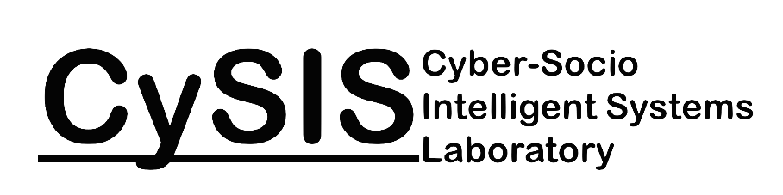

Diffusion in Social Networks
Updated slide – final version that was presented on July 26, 2015 as an IJCAI full-day tutorial.

Slide 2

CySIS Lab
The Cyber-Socio Intelligent Systems (CySIS) Laboratory is part of the School of Computing, Informatics, and Decision Systems Engineering (CIDSE), part of the Fulton Schools of Engineering at Arizona State University. The CySIS Lab is primarily focused on conducting basic research relating to challenging problems in cyber security, social network mining, security informatics, and artificial intelligence with the goal of creating intelligent systems that have a significant impact on real-world problems.
Director
Paulo Shakarian, Ph.D.
shak@asu.edu

Slide 3




CySIS Lab: Social Network Analysis Group
Ashkan Aleali
aleali@asu.edu
Abhinav Bhatnagar
Abhinav.Bhatnagar@asu.edu
Ruocheng Guo
Ruocheng.Guo@asu.edu
Elham Shabaani
elham.shaabani@asu.edu

Slide 4
Diffusion in Social Networks
In Fall, 2015, Springer will be publishing a new volume:
Diffusion in Social Networks
Provides more in-depth coverage on the topics of this tutorial.
A preprint, along with these slides can be found at:
http://lab.engineering.asu.edu/cysis/diffusion/

Slide 5
Tutorial Objectives
Introduction to network diffusion models from not just computer science but other disciplines including sociology, physics, biology, and epidemiology
Understand the standard techniques to compute the outcome of a diffusion process
Understand the relationship between centrality and diffusion
Understand the considerations when seeking to identify a set of nodes that maximize spreading
Have a running knowledge of major empirical results and the latest in data-driven approaches

Slide 6
Tutorial Schedule
8:45 am – 10:30 am
Intro
SIR and SIS Models
Tipping and target set selection
Kempe-Kleinberg-Tardos Part 1 (models and theoretical results)
10:30 am – 11:00 am
Coffee break
11:00 am – 12:45 pm
Kempe-Kleinberg-Tardos Part 1 (continued, models and theoretical results)
Kempe-Kleinberg-Tardos Part 2 (scalable algorithms)
12:45 pm – 2:00 pm
Lunch
2:00 pm – 3:30 pm
Logic Programming Based Diffusion
Evolutionary Graph Theory (EGT)
3:30 pm – 4:00 pm
Coffee break
4:00 pm – 5:45 pm
Empirical Results
Data-driven Approaches
Open Problems

Slide 7
SIR and SIS Models
Tipping Model and Target Set Selection
Kempe-Kleinberg-Tardos (KKT) Framework Part I
Kempe-Kleinberg-Tardos (KKT) Framework Part II
Logic Programming Based Diffusion
Evolutionary Graph Theory (EGT)
Empirical Results
Data-driven approaches
Open Problems

Slide 8
Model Basics
Infection
I
Removal
R
S
Recovery
Recovery
Susceptible
Infected
Removed

Slide 9
Model Basics
A node can be in one of many states:
Susceptible: Able to be infected
Infected: Able to infect
Removed: Not able to infect or be infected
Though we only have 2-3 states for each node, we have an exponential number of states for the entire network!

Slide 10
SIR Model
Infection
β
I
Removal
𝜸
S
R
Recovery
Recovery
Removed
(immune / dead)
Susceptible
(healthy)
Infected
(sick)

Slide 11
SIR Model
Parameter β, 𝜸 are a reals in [0,1]
Each node in one of three states: S, I, or R
At each time step:
If a node is in state I, it attempts to infect each of its outgoing neighbors which are in S state and is successful with a probability of β
After attempting to infect its susceptible neighbors, the node moves to the R state with probability 𝜸 (in some variants, the node remains in the I state for multiple time steps)
If node is in the S state and is infected by an I node, it moves to the I state in the next time step

Slide 12
SIR Model in term of differential equations
N size of the crowd
S(t) number of susceptible individuals at time t
I(t) number of infected individuals at time t
R(t) number of recovered individuals at time t
N = S(t) + I(t) + R(t)
Assuming fully connected network

Slide 13
SIR Model in term of differential equations
No recovered at time 0.
N=I+S+R
Notes:
1: The change of susceptible over time. ‘I’ infected nodes try to infect S susceptible nodes. They will succeed with prob. \beta. So, in the next iteration, number of nodes in ‘S’ will decline accordingly.
2: The change of removed over time. # nodes who successfully move from infected state to removed (with prob. \gamma).
3: The change of infectees over time. # of newly infected nodes - # of nodes moving from infected to removed (with prob. \gamma)
4: divide the first arrow by second arrow
5: solving the equations. The rest is clear.

Slide 14
SIR Model in term of differential equations
No closed form solution exists for the integration

Slide 15
SIS Model
Infection
β
Removal
S
I
R
Recovery
λ
Recovery
Recovery
Susceptible
Infected
Removed

Slide 16
SIS Model
Parameter β, λ are reals in [0,1]
Each node in one of two states: S or I
At each time step:
If a node is in state I, it infects attempts to infect each of its outgoing neighbors that are in the S state and is successful with a probability of β
After attempting to infect its susceptible neighbors, the node moves back to the S state with probability λ (in some variants, the node remains in the I state for multiple time steps)
If node is in the S state and is infected by an I node, it moves to the I state in the next time step

Slide 17
Monotonicity
At each time step, do the number of susceptible individuals increase or decrease?
SIS
It depends
SIR
Number of susceptible individuals ALWAYS stay the same or decrease
Hence, number of recovered individuals will ALWAYS stay the same or INCREASE

Slide 18
Outcomes
SIR: Expected number of infected individuals
Given an initial set of nodes in the infected (I) state, the expected number of infectees is the probabilistic average of the number of individuals that are ever infected (as time approaches infinity).
SIS: Spreading Efficiency of a Node
The probability that a node is in state I as time approaches infinity.

Slide 19
Estimating the Expected Number of Infectees through Simulation
Simulation is widely used to study SIR and SIS on networks.
Origin: The single node selected to be in the infected state
In many studies, where the focus is on the structure of the population, this is selected at random for each simulation run.
Seed set: Set of node initially selected to be in the infected state
Simulation Run: One sequence of simulation steps, where the next action is selected at random (based on the probabilities specified in the parameters).

Slide 20
Estimating the Expected Number of Infectees through Simulation
SIR Simulations are normally run with a seed set until no nodes are in the I state. The expected number of infectees is simply the average number of nodes in the R state over all runs.
SIS Simulations are normally run until an equilibrium is observed where as many nodes become infected as those become recovered. Spreading efficiency of the nodes is estimated also based on an average.

Slide 21
Computing Expected Number of Infectees Exactly
Simulation is costly!
Also, when do we have enough simulations?
Generally done based on observation
Not many useful results on a good number of simulations
Can we avoid it by finding an efficient algorithm to calculate the expected number of infectees exactly?

Slide 22
Bad News
Calculating the number of infectees under the SIR model is #P-hard
#P is a complexity class that is beyond the polynomial hierarchy
This makes the problem harder than an NP-Complete problem
In fact, we are not guaranteed a PTIME solution even if P=NP!!
Notes:
#P comes from the KKT IC model which is a generalization of SIR. We will talk about it in the KKT section.

Slide 23
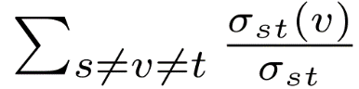
Centrality and Expected Number of Infectees
Can centrality be used to estimate expected number of infectees from a singleton?
Intuition: Radial measures better suited
Radial
Degree
Closeness
Eigenvector
PageRank
Neighborhood
Medial
Betweenness

Slide 24
Kitsak et al: Connections Aren’t Everything
In many of the models we covered previously, there are analytical results that show that nodes of high degree are effective origins for spreading under the SIR and SIS models.
However, in real-world networks, the shell number and nodal degree do not always correlate.
For instance, node b (high-degree, low-core) normally does not get created in simulated networks, but appears often in real-world ones.
The intuition is that nodes like node a are more effective in spreading disease under the SIR and SIS models.
a
b

Slide 25
Shell Number
The K-core of a graph is the largest subgraph in which all nodes have degree K or greater within that subgraph.
The K-shell of a graph is all nodes in the K-core but not in some K’-core where K’ > K.
A node’s shell number is the number of the associated shell it belongs to.

Slide 26
Shell Decomposition
Recursively remove nodes with the lowest degree.
To remove k-shell, keep removing nodes with degree = k.
An efficient way of finding the shell numbers.
Runs in linear time.
1
1
2
2
2
4
4
4
4
4
1
1

Slide 27
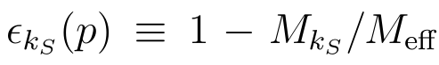
Imprecision Metric
For the top p fraction of nodes based on top k-shell value:
M_{ks} is the spreading ability of the nodes selected based on shell number.
M_{eff} is the spreading ability of the best set of nodes.
Lower value means the selected nodes can spread as good as the optimal set of nodes.
Analogously defined for other centrality measures.

Slide 28
Experiments and Results
The authors examined 8 real-world network datasets and ran SIR/SIS simulations comparing the top “spreaders” (origin nodes) based on degree, shell decomposition, and simulation.
Macdonald, Brian, et al. "Spreaders in the Network SIR Model: An Empirical Study." arXiv preprint arXiv:1208.4269 (2012).

Slide 29
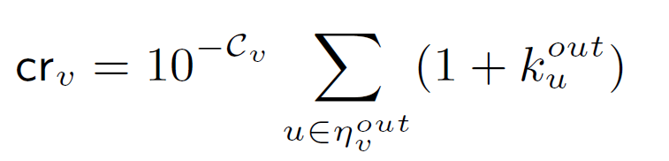
ClusterRank (Chen et al.)
A centrality measure where the clustering coefficient is used as a factor
Intuition: Centrality decreases with clustering but increases with the degree of its neighbors.
(Later, we shall see that this seems to work for other diffusion models as well).
Notes:
http://www.plosone.org/article/info%3Adoi%2F10.1371%2Fjournal.pone.0077455

Slide 30
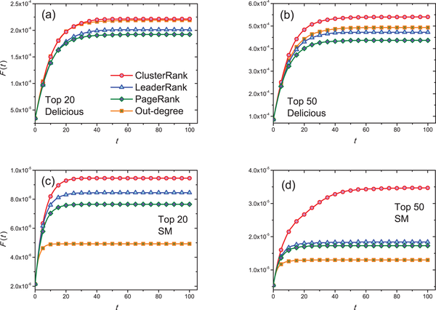
For top- ranked nodes by out-degree centrality (squares), PageRank (diamond), LeaderRank (triangle) and ClusterRank (circles).
Chen D-B, Gao H, Lü L, Zhou T (2013) Identifying Influential Nodes in Large-Scale Directed Networks: The Role of Clustering. PLoS ONE 8(10): e77455. doi:10.1371/journal.pone.0077455
http://www.plosone.org/article/info:doi/10.1371/journal.pone.0077455
Notes:
We add a ground node to the graph. Add bidirectional edges from each node to the node. Applying standard random walk to the newly connected graph.

Slide 31
Reference
Newman, M.E.J., Girvan, M. (2004). Finding and evaluating community structure in net- works. Phys. Rev. E 69 (2), 026,113.
Kitsak, M., Gallos, L.K., Havlin, S., Liljeros, F., Muchnik, L., Stanley, H.E., Makse, H.A. (2010).Identification of influential spreaders in complex networks. Nat Phys (11), 888–893.
Jackson,M.,Yariv,L.(2005).Diffusion on social networks. Economie Publique ,vol.16, pp. 69–82.
Centola,D.(2010).The Spread of Behavior in an Online Social Network Experiment. Science 329 (5996), 1194-1197.
Carmi, S., Havlin, S., Kirkpatrick, S., Shavitt, Y., Shir, E. (2007). From the Cover: A model of Internet topology using k-shell decomposition. PNAS 104 (27), 11,150 - 11,154.
P. Shakarian, S. Eyre, D. Paulo. A Scalable Heuristic for Viral Marketing Under the Tipping Model. Social Network Analysis and Mining. Springer 3(4), 2013.
P. Shakarian, D. Paulo. Large Social Networks can be Targeted for Viral Marketing with Small Seed Sets. 2012 IEEE/ACM International Conference on Advances in Social Networks Analysis and Mining (ASONAM-2012) (Aug. 2012).

Slide 32
SIR and SIS Models
Tipping Model and Target Set Selection
Kempe-Kleinberg-Tardos (KKT) Framework Part I
Kempe-Kleinberg-Tardos (KKT) Framework Part II
Logic Programming Based Diffusion
Evolutionary Graph Theory (EGT)
Empirical Results
Data-driven approaches
Open Problems

Slide 33
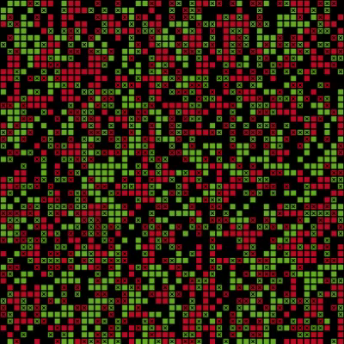
Schelling: Racial Segregation
Given a grid where each square represents a residence.
Each residence is colored green or red – representing one of two races.
Model: If a square of a certain color is surrounded by at least 60% of the other race, then the individual at that square “moves” and is replaced by the other color.

Slide 34
Schelling: Racial Segregation
Overtime, the neighborhoods reach a fixed point and become segregated.
We can view this as a tipping process on a lattice graph.
We can generalize this to regular graphs to better understand the spread of a behavior.

Slide 35
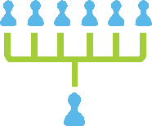





Tipping
The “tipping point” is often referred to in popular literature.
First introduced in Schelling ‘78 and Granovetter ‘78
In layman’s terms:
Every member of the population has a threshold k
If k number of your friends adopt a behavior – then you will too.

Slide 36
Tipping
The idea of “tipping” can be extended to social networks to describe a diffusion process.
We will often say a node is “activated” if it has adopted a certain behavior.
b
h
a
j
c
g
d
i
e
f

Slide 37
Preliminaries
We assume a directed network and a threshold function that provides the percentage of “active” neighbors required to tip that node.
G = (V, E)
∀ v_{i}, η_{i}^{in} is the set of incoming neighbors
θ : V → (0,1]
∀ v_{i} ∈ V, k_{i} = ⎡θ(v_{i}) d_{i}^{in}⎤

Slide 38
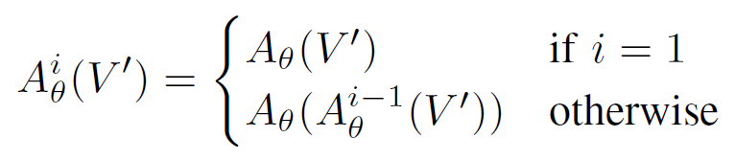
Activation Function
Maps subsets of vertices (nodes activated at the current time step) to subsets of vertices (nodes activated at the next time step)
Defined for multiple iteration below:

Slide 39
The Activation of Nodes
Consider the social network on the left.
Suppose we have a majority threshold:
∀v_{i} ∈ V, θ(v_{i})=0.5
b
h
a
j
c
g
d
i
e
f

Slide 40
The Activation of Nodes
Initially individuals h and j are activated.
b
h
a
j
c
g
d
i
e
f

Slide 41
The Activation of Nodes
Initially villages h and j are activated.
This leads to g and i also becoming activated in the next time step.
But no others.
b
h
a
j
c
g
d
i
e
f

Slide 42
Determining the Outcome of a Diffusion Process
For any initial set of nodes (seeds), we can calculate the outcome of the diffusion process in no more than n steps.
Proof:
Suppose, BWOC, that it takes more than n steps.
However, we know at each step at least one node must activate (or it terminates).
As there are only n nodes in the network, it cannot take more than n steps – a contradiction.
Note that each step can be calculated in O(k*) time, where k* is the maximum degree.

Slide 43
Non-Submodularity
Sometimes, adding an additional node can give an enhanced effect: the result is greater than the sum of the parts!
k=2 for all nodes
i
i
i
i
g
j
g
j
g
j
g
j
h
k
h
k
h
k
h
k
Incremental increase of adding node g to the empty set: 1
Incremental increase of adding node g to set {h} : 4

Slide 44
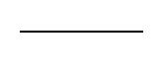
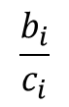
The Jackson-Yariv Model
Extension of the Tipping Model
Each node v_{i} has an associated cost and benefit, c_{i}, b_{i}.
The function g : {0,…,n-1} → [0,1] maps naturals to a benefit value.
i.e. g(3) is the benefit a node receives if three of his neighbors previously adopt.
x g(d_{i}^{in})
$$\frac{b_{i}}{c_{i}}$$
d_{i}^{in}
This quantity is similar to an “expected benefit”

Slide 45
The Jackson-Yariv Model
The population of those adopting increases with increasing speed at first, and then decreasing speed later on
For higher values of g(d) the returns from a marginal increase in the probability of a neighbor adopting is higher and hence the tipping point is lower

Slide 46
Why Centrality Won’t Cut It
If the threshold for all nodes is greater than 1, then:
No single node will cause any cascading effect!
A set of nodes with no common neighbor will also NOT cause a cascade.

Slide 47
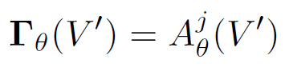
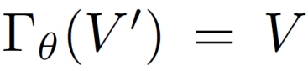
Formal Problem Statement
Clearly, the tipping process must complete in less than |V| time steps
For j > |V|, we define the following:
The MIN-SEED problem is to find a set V’ ⊆V of minimal size that causes
This problem has been shown to be NP-Complete. (Dreyer & Roberts, ‘09)

Slide 48
Variants
Decision: Find a set of nodes of size K such that X nodes are infected once the diffusion process converges.
Minimum Cardinality: Find a minimal set of nodes such that X nodes are infected once the diffusion process converges.
Maximum Spread: Find a set of K nodes such that the number of nodes infected is maximized.
Special cases: Set X=n, majority thresholds, thresholds equal to 2, special network topologies, etc.

Slide 49
Membership in NP
Decision variant: for natural k, can we identify a set of nodes of size k or less that causes X number of individuals to adopt?
We can solve the minimization problem with n decision problems
Membership in NP (verifying a solution in PTIME) stems from the fact that the diffusion process in a tipping model can be computed in PTIME

Slide 50
NP-Hardness of Maximization Variant: Relationship with Max-K-Cover
Again, we use a covering problem to show NP-hardness.
Max-K-Cover: Given a set of elements S and a collection of subsets of elements, H, can we identify a subset of H of size K such that the number of elements covered in S by their union is maximized?
Construction:
Draw a graph where nodes are elements of S and H
For each h node (corresponding to an element in H) draw a directed edge to all S-nodes that area members of h
Set all thresholds equal to 1

Slide 51
NP-Hardness of Maximization Variant: Relationship with Max-K-Cover
Example:
Set {x1, x2, x3, x4}
Family {x1, x2}, {x3, x4}, {x2}, {x1,x3,x4}
Note: For any solution to Max-K-Cover containing node x1, x2, x3, or x4, there is an equally optimal solution containing only family nodes.
Note: This construction
does not work for X=n! For that, a more involved proof using indepent set can be used – see Dreyer & Roberts, ’09.
_{{x1,x3,x4}}
_{{x3,x4}}
_{x1}
_{{x1,x2}}
_{x2}
_{x3}
_{{x2}}
_{x4}

Slide 52
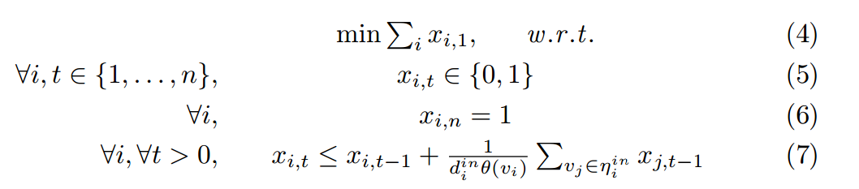
Brute-Force Solution through Integer Programming
Good news: The entries in the vector correspond to a solution!
Bad news: Integer programming also NP-hard
More Bad news: n² number of variables, so even approximations will be slow

Slide 53
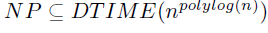
Some Theoretical Results
If a seed set cannot be approximated within a certain factor for arbitrary thresholds, then it cannot be approximated for majority thresholds or thresholds greater than 2 within that same factor (Chen ‘09)
Target set selection cannot be approximated within O(2log^{(1-ε)}n) for ε>0 unless (Chen ‘09).
Solvable on trees in polynomial time if the network is a tree (Chen ‘09)
For treewidth w (treewidth decomposition computation is NP-hard), solvable in O(tO(w) n) time where t is the maximum threshold of the network (Ben-Zwi et al., 2011)

Slide 54
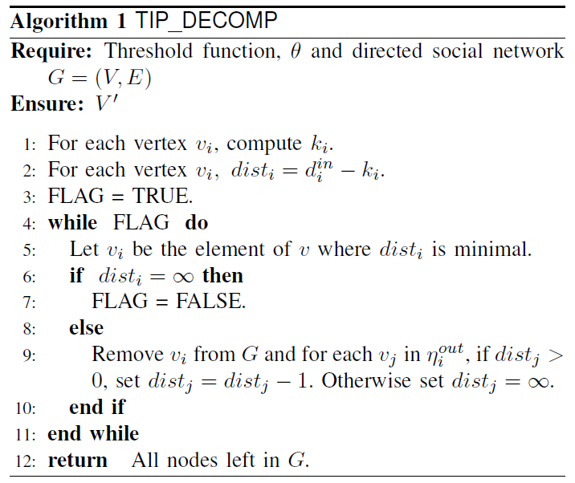
Decomposition-Based Heuristic
TIP_DECOMP runs in O(M lg N) time and guarantees that the result will lead to adoption of the behavior by the entire population.
Does not guarantee minimal size – but it finds very small seed sets in practice.

Slide 55
Decomposition-Based Heuristic
Let us consider the following network.
First, our algorithm identifies the threshold for each node to be tipped. If we assume at least 50% of each neighbor is required, then this number is shown in red.
b
h
1
1
a
1
1
j
c
2
g
2
d
2
i
1
e
1
f
1

Slide 56
Decomposition-Based Heuristic
Next, the distance to being tipped is computed. This is defined as the node’s current degree minus the threshold.
It is shown for each node in blue.
b
h
1
0
a
1
1
j
c
2
g
1
d
1
i
0
e
0
f
0

Slide 57
Decomposition-Based Heuristic
The algorithm then proceeds as follows:
At each iteration, remove the node whose distance is the smallest but non-negative (and the adjacent edges).
Then update the distances of its neighbors.
b
h
1
0
a
1
1
j
c
2
g
1
d
1
i
0
e
0
f
0

Slide 58
Decomposition-Based Heuristic
The algorithm then proceeds as follows:
At each iteration, remove the node whose distance is the smallest but non-negative (and the adjacent edges).
Then update the distances of its neighbors.
b
1
a
1
1
j
c
2
g
0
d
1
i
0
e
0
f
0

Slide 59
Decomposition-Based Heuristic
The algorithm then proceeds as follows:
At each iteration, remove the node whose distance is the smallest but non-negative (and the adjacent edges).
Then update the distances of its neighbors.
b
1
a
1
0
j
c
2
g
0
d
1
e
0
f
0

Slide 60
Decomposition-Based Heuristic
The algorithm then proceeds as follows:
At each iteration, remove the node whose distance is the smallest but non-negative (and the adjacent edges).
Then update the distances of its neighbors.
b
1
a
1
0
j
c
2
g
0
d
0
e
0

Slide 61
Decomposition-Based Heuristic
The algorithm then proceeds as follows:
At each iteration, remove the node whose distance is the smallest but non-negative (and the adjacent edges).
Then update the distances of its neighbors.
b
1
a
1
0
j
c
2
g
0
d
-1

Slide 62
Decomposition-Based Heuristic
The algorithm then proceeds as follows:
At each iteration, remove the node whose distance is the smallest but non-negative (and the adjacent edges).
Then update the distances of its neighbors.
b
1
a
1
c
2
g
-1
d
-1

Slide 63
Decomposition-Based Heuristic
The algorithm then proceeds as follows:
At each iteration, remove the node whose distance is the smallest but non-negative (and the adjacent edges).
Then update the distances of its neighbors.
b
0
c
1
g
-1
d
-1

Slide 64
Decomposition-Based Heuristic
The algorithm then proceeds as follows:
At each iteration, remove the node whose distance is the smallest but non-negative (and the adjacent edges).
Then update the distances of its neighbors.
c
0
g
-1
d
-1

Slide 65
Decomposition-Based Heuristic
The algorithm then proceeds as follows:
At each iteration, remove the node whose distance is the smallest but non-negative (and the adjacent edges).
Then update the distances of its neighbors.
g
-2
d
-2
Solution = { d, g }

Slide 66
A
B
C

Slide 67
Finding a seed set in the Hyves social network:
1.4 M nodes
5.5 M edges
12.2 minutes runtime
Linear fit, r²= 0.90

Slide 68
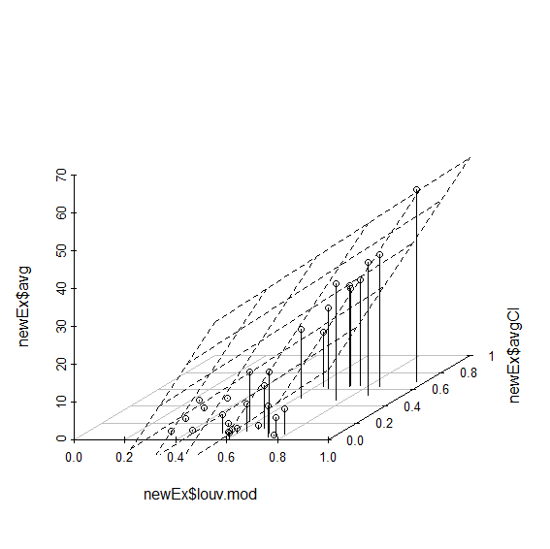
Planar fit, r²=0.87
Average Seed Size (Percent of Nodes)
Average Clustering Coefficient
Louvain Modularity

Slide 69
Reference
Anderson, Roy M.,May, Robert M.(1979).Population biology of infectious diseases: Parti. 280 (5721), 361.
Borgatti, S., Everett, M.(2006).A Graph-theoretic perspective on centrality. Social networks 28 (4), 466–484.
Callaway, Duncan S., Newman, M. E. J., Strogatz, Steven H., & Watts, Duncan J. (2000). Network robustness and fragility: Percolation on random graphs. Phys. rev. lett. , 85(Dec), 5468–5471.
Carmi, Shai, Havlin, Shlomo, Kirkpatrick, Scott, Shavitt, Yuval, & Shir, Eran (2007). From the Cover: A model of Internet topology using k-shell decomposition. Pnas , 104 (27), 11150– 11154.
Castellano, & Pastor Satorras, Romualdo. (2012). Competing activation mechanisms in epidemics on networks. Scientific reports, 2 (371).
Chen, Duanbing, L, Linyuan, Shang, Ming-Sheng, Zhang, Yi-Cheng, & Zhou, Tao (2012). Identifying influential nodes in complex networks. Physics a: Statistical mechanics and its applications, 391(4), 1777 – 1787.
Freeman, Linton C.(1979). Centrality in social networks conceptual clarification. Social networks, 1 (3), 215 – 239.
Kitsak, Maksim, Gallos, Lazaros K., Havlin, Shlomo, Liljeros, Fredrik, Muchnik, Lev, Stanley, H. Eugene, & Makse, Hernan A. (2010). Identification of influential spreaders in complex networks. Nat phys, 6 (11), 888–893.

Slide 70
SIR and SIS Models
Tipping Model and Target Set Selection
Kempe-Kleinberg-Tardos (KKT) Framework Part I
Kempe-Kleinberg-Tardos (KKT) Framework Part II
Logic Programming Based Diffusion
Evolutionary Graph Theory (EGT)
Empirical Results
Data-driven approaches
Open Problems

Slide 71
KKT Framework Part I
Independent Cascade Model
IC generalizes SIR
#P hardness of finding the expected number of infectees for IC
Influence maximization problem under the IC model
Complexity and approximation
Linear Threshold Model
The Linear Threshold Model
LT Max Infulence: Complexity, Submodularity, and Approximation
Experimental Evaluation
Generalizing LT and IC

Slide 72
Remember the SIR Model?
Infection
I
Removal
R
S
Recovery
Recovery
Susceptible
Infected
Removed

Slide 73
The Independent Cascade (IC) Model
Generalizes the SIR Model
Introduced by Kempe, Kleinberg, and Tardos in 2003 (KKT)
Instead of a single probability of infection, there is a probability of infection associated with each edge
The probability p_{uv} associated with edge (u,v) is “the probability of u infecting v”
Based on frequency of interaction
Based on geographic proximity
Based on historical infection traces
Each node, once infected, has the ability to infect its neighbor in the next time step based on the probability associated with that edge.

Slide 74
Expected Number of Infectees
Given an initial set of nodes, S, the expected number of infectees is denoted σ_{IC}(S).
Note that the expected number of infectees includes the nodes in S.
As we can generalize the SIR model in the IC model, calculating the expected number of infectees is #P-hard.
Hence, simulation is often used.

Slide 75
The Live-Edge (Live-Arc) Model
The given graph G=(V,E) (with edge probabilities specified by vector p), we can view some sub-graph G’=(V,E’) as a potential set of available edges that diffusion can deterministically occur.
The Live-Edge model is just a probability distribution over subgraphs of G.
For the IC model, the probability of G’ being a realized outcome can be assigned a probability as follows:
Pr(G’) = Π_{(u,v) ∈ E’} p_{uv} × Π_{(u,v) ∈ E-E’} (1-p_{uv} )

Slide 76
The Live-Edge (Live-Arc) Model
For any S, we have the following relationship:
σ_{IC} (S)=Σ_{G’} Pr(G’) × σ_{G’} (S)
NB: This is a key relationship between the two models – this equivalence lies at the heart of many proofs involving the KKT models (IC, LT, and related variants).

Slide 77
Showing #P-hardness of σ computation under the IC model
#P-hard problems deal with counting the number of solution.
Problem used in reduction: # s-t connectivity:
Given a graph and nodes s,t count the number of subgraphs in which s and t are connected?

Slide 78
Showing #P-hardness of σ computation under the IC model
Construction:
Take the graph G from s-t connectivity, and for each edge (u,v) set p_{u,v} = 0.5.
Node that the probability distribution over subgraphs in the equivalent live edge model is a uniform distribution
Hence, the number of subgraphs where s and t are connected is proportional to the probability of s being infected by t under the IC model.

Slide 79
Showing #P-hardness of σ computation under the IC model
Construction:
So, now the trick is to calculate the probability of t being infected.
Create graph G’ by adding node t’ and directed a edge from t to t’. Set p_{t,t’} = 1.0.
Given seed set {s}, the probability of t’ getting infected in G’ is equal to the probability of t getting infected in G.

Slide 80
Showing #P-hardness of σ computation under the IC model
Construction:
We also have the relationship that the probability of t’ becoming infected by s is the difference between σ_{G’}^{IC}({s})- σ_{G’}^{IC}({s})
Hence, with two calls to an exact computation of σ, we can find the probability of t’ being infected by s (which is the same as the probability of t being infected by s) and is proportional to the number of subgraphs where s is connected to t.

Slide 81
Influence Maximization Under the IC Model
KKT introduces the influence maximization problem.
Given a network with influence probabilities, and natural number K, identify a set of nodes S of size K or smaller such that σ_{IC}(S) is maximized.

Slide 82
NP-Hardness: Relationship with Max-K-Cover
Again, we use a covering problem to show NP-hardness.
Max-K-Cover: Given a set of elements S and a collection of subsets of elementns, H, can we identify a subset of H of size K such that the number of elements covered in S by their intersection is maximized?
Construction:
Draw a graph where nodes are elements of S and H
For each h node (corresponding to an element in H) draw a directed edge to all S-nodes that area members of h
Set influence probabilities equal to 1

Slide 83
NP-Hardness: Relationship with Max-K-Cover
Example:
Set {x1, x2, x3, x4}
Family {x1, x2}, {x3, x4}, {x2}, {x1,x3,x4}
For K=2, pick {x1,x2} and {x3,x4}
Expected number of infectees is 6.
Note: The NP-hardness result holds even if the expected number of infectees is computed in PTIME! The IIP text shows a #P-hardness proof that does depend on the complexity of the oracle.
_{{x1,x3,x4}}
_{{x3,x4}}
_{x1}
_{{x1,x2}}
_{x2}
_{x3}
_{{x2}}
_{x4}

Slide 84
What to do about complexity?
Resort to an approximation algorithm!
Though computing σ_{IC} is #P-hard, we can obtain “arbitrarily close” approximation using simulation (though expensive!)
So, lets assume that we can solve σ_{IC} efficiently, what can we do then?

Slide 85
Enter Nemhauser
Let U be a set of elements and function f : 2^{U} → R⁺
Given a natural number K, consider finding a subset X of U of size K such that f(X) is maximized.
In 1978, Nemhauser, Wolsey, and Fisher showed that a greedy algorithm provides an 0.63 approximation (in the limit of K) if f meets the following conditions:
Normalization: f(∅)=0
Monotonicity: For X ⊆ X’, f(X) ≤ f(X’)
Submodularity: S’’ ⊆ S’ ⊆ U and x ∉S’, we have:
f(S’ U {x} ) – f(S’) ≤ f(S’’ U {x} ) – f(S’’)

Slide 86
Normalization
Trivial:
σ_{IC}(∅)=0
If there is no seed (initial infectees) then there is no spread!
Some of the combinatorial results can be modified if normalization does not hold.

Slide 87
Monotonicity
For X ⊆ X’, σ_{IC}(X) ≤ σ_{IC} (X’)
Note that σ_{IC} is the total number of expected infectees, hence each element of X contributes at least 1 expected infectee – hence monotonicity easily follows.
However this is not true if we do not count nodes in set X toward the expected infectees. In this case, we can view the oracle function as σ_{IC}(X) - |X|, which is not monotonic. This is a special case of profit maximization.

Slide 88
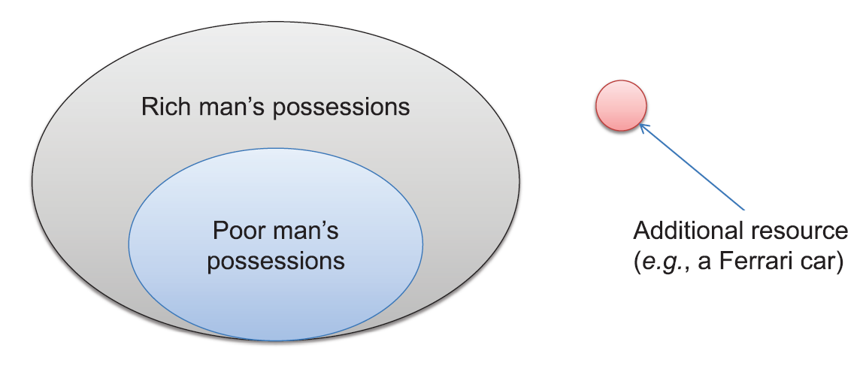
Submodularity
Intuitively, a submodular function has diminishing returns.
Given: Set S Function f : 2^{S}→R⁺
We say f is submodular iff for every S’’ ⊆ S’ ⊆ S and x ∉S’, we have:
f(S’ U {x} ) – f(S’) ≤ f(S’’ U {x} ) – f(S’’)

Slide 89
Showing Submodularity: The Live-Edge (Live-Arc) Model
The given graph G=(V,E) (with edge probabilities specified by vector p), we can view some sub-graph G’=(V,E’) as a potential set of available edges that diffusion can deterministically occur.
Hence, the probability of G’ being a realized outcome can be assigned a probability as follows:
Pr(G’) = Π_{(u,v) ∈ E’} p_{uv} × Π_{(u,v) ∈ E-E’} (1-p_{uv} )

Slide 90
Showing Submodularity: The Live-Edge (Live-Arc) Model
Under the live-edge model, for given graph, G’, let σ_{G’}(S) be the expected number of nodes infected given initial set S.
As, for a given sub-graph G’, the infection is deterministic, a node x is infected under the live-edge model if there is simply a path from a node in S to x!
So, consider the following claim:
For given G’, σ_{G’} is sub-modular.

Slide 91
Showing Submodularity: The Live-Edge (Live-Arc) Model
For given G’, σ_{G’} is sub-modular.
Consider two sets, S,S’ where S’ is a superset of S and element s which is in neither. Consider sets R(S), R(S’), and R({s}) which are the nodes reachable by S,S’, and s respectively (note the cardinality of these sets is the expected number of infectees under live-edge for G’).
The set of nodes R(S) ∩ R({s}) is the set of all nodes reachable by a node in S and {s}.
We can show submodularity by proving that | R(S’) ∩ R({s}) | ≥ | R(S) ∩ R({s}) |
Why? As S’ is a superset, it contain as many or more of the reachable nodes from s than S does.

Slide 92
Showing Submodularity: The Live-Edge (Live-Arc) Model
So, since for any G’, σ_{G’} is submodular, we can complete the proof.
For any S, we have the following relationship:
σ_{IC} (S)=Σ_{G’} Pr(G’) × σ_{G’} (S)
As positive linear combinations of submodular functions are also submodular, we have completed the proof!

Slide 93
Greedy Approximation
So, now we can use the greedy approximation an obtain the theoretical guarantee.
The algorithm proceeds as follows:
Set S = ∅
While |S| ≤ K
Pick v ∈ V-S where σ_{IC}(S ∪ {v})- σ_{IC}(S) is the greatest
Add v to S
Return S

Slide 94
Greedy Approximation
positives
negatives
Runs in polynomial time (with a PTIME approximation for σ_{IC}).
“Provable” approximation ratio
Easy to implement
O(nK) evaluations of σ_{IC} – this is expensive as σ_{IC} is normally calculated by simulation (later we will see how to speed this up somewhat)
Approximation ratio only holds if you have an oracle to σ_{IC} – which is #P-hard to evaluate (and there is no known approximation)

Slide 95
Remember the Tipping Model
The “tipping point” is often referred to in popular literature.
First introduced in Schelling ‘78 and Granovetter ‘78
In layman’s terms:
Every member of the population has a threshold k
If k number of your friends adopt a behavior – then you will too.

Slide 96
Linear Threshold Model (LT)
We assume that the thresholds are not observed.
And instead the thresholds are selected with a uniform probability distribution.
(The KKT paper extends tipping to its natural, weighted variant where each directed edge has a nonnegative weight and the sum of incoming edge weights sum to less than or equal to one)

Slide 97
Comparison: Tipping and LT
Deterministic tipping
Lt model
Thresholds are deterministic
Calculating outcome of diffusion is in PTIME
Target set selection NP-Complete
Oracle is not sub-modular
With non-trivial thresholds, need a set of nodes to initiate diffusion
Thresholds are probabilistic
Calculating outcome of diffusion is #P-Hard
Maximum Influence is NP-Hard
Oracle is sub-modular
Single-node initiated diffusion can potentially cause a high number of infected nodes in expectation

Slide 98
Equivalence to the Live-Arc Model
In the analysis of the LT model, we use the “live arc” model for much of the analysis.
However, the key difference is that the probability over the deterministic graphs will be different from the case of the independent cascade (and SIR) model.
Key intuition: for each node, we care about the last incoming neighbor that led to activation.

Slide 99
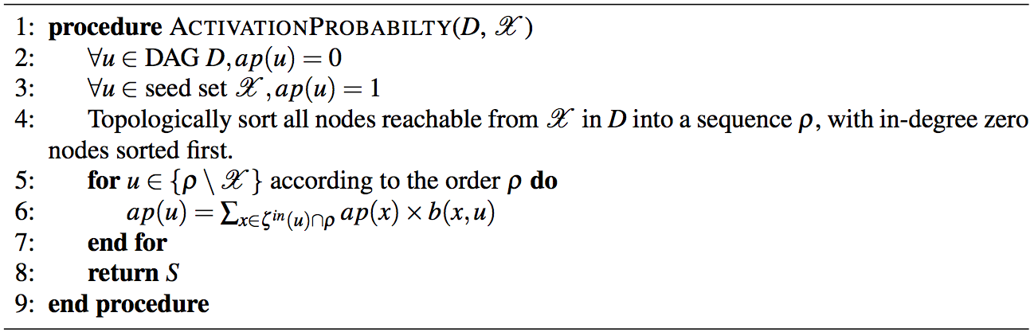
Expected number of infectees Solvable in PTIME for DAGs
Intuition: Without circularity, each level of nodes in the DAG cannot be influence by nodes they have a directed path to – hence the calculation becomes straightforward.

Slide 100
Expected number of infectees Solvable is #P-hard for general graphs
Intuition: Leverages known #P-hard problem: counting number of simple paths (#SIMPATH) in a directed graph.
Given input for #SIMPATH (graph G) create G’ by adding node s and creating a directed edge from s to each node in G. The node s is used as an origin of the diffusion process.
Note that subgraphs for non-zero probability outcomes in the live-arc model can be viewed as sets of simple paths (as each node will only have one incoming edge). We can also set the edge weights to be equal.
Remainder of the proof leverages the live-arc technique (again).

Slide 101
NP-Hardness
Reduction from known NP-hard problem vertex cover.
Vertex cover. Given a (undirected) graph G and natural k, is there a set S of k nodes in G s.t. each edge is adjacent to a node in S?
Given a vertex cover graph G, create an instance of max-influence problem with a directed version of G (arrows in both directions*). For each node v, set the weight of all its incoming edges to be the reciprocal of v’s in-degree.
Clearly, a solution to vertex cover is of size k and activates the entire network with a probability of 1.0 in 1 time-step – providing the maximum expected number of infectees possible (|V|).
Going the other way, any solution of size k to the max-influence problem that infects |V| vertices must also be a vertex cover, as it must reach all neighbors in 1-time step to infect them with a probability of 1.0 (and must infect them through all incoming edges).
*Note that this causes each node to have a two adjacent edges.

Slide 102
Submodularity
Recall:
For the IC model we leveraged the live-arc (a.k.a. live edge) model and showed that the oracle in that model is sub-modular.
The main difference between the live-arc model for IC and LT is that the PDF over the set of outcomes (possible worlds) is different.
However, this does not matter in the submodularity proof as the PDF only provides coefficients for a non-negative sum over submodular functions, which is also submodular.

Slide 103
Applying the Greedy Algorithm (again)
LT is clearly normalized (no seeds – no diffusion)
Monotonicity of the LT model follows the same argument we showed last lesson for the IC model.
We showed submodualrity in the last slide.
These three properties allow us to again use the greedy algorithm and get a 0.63 (1-1/e) approximation guarantee by the result of Nemhauser and Wolsely given that we can compute the outcome of the diffusion process exactly.

Slide 104
Generalized Threshold Model
Each node v has a threshold function f_{v} that maps subsets of nodes to a scalar in [0,1].
Each node draws a a threshold value in [0,1] from a uniform probability distribution.
A node v is infected at each time step if f_{v}(S_{v}) is greater or equal to the threshold.

Slide 105
Generalized Threshold Model: Main Results
KKT03: The LT is a special case of the generalized threshold model.
KKT03 introduced a generalization of the IC model called the generalized cascade model.
KKT03 shows that the generalized threshold and generalized cascade models are equivalent
KKT03 show it is NP-hard to approximate the Generalized Threshold model within a non-trivial factor
Mossel and Roch 07 show that if all the f_{v} functions are normalized, monotonic, and submodular, then the expected number of infectees under the generalized threshold model is also normalized, monotonic, and submodualr.

Slide 106
Another Generalization: Decreasing Cascade Model
Special case of Generalized Threshold Model
Here for each edge directed from u v and subset S of v’s incoming neighbors (that does not include u), we specify a probability p_{v}(u,S) such that for any superset T of S we have:
p_{v}(u,S) ≥ p_{v}(u,T)
In Kempe et al. ’05, the authors show that the associated oracle is also normalized, montonic, and submodular.

Slide 107
Reference
Kempe, David and Kleinberg, Jonand and Tardos. Maximizing the spread of influence through a social network. (2003) ACM 137–146.
Nemhauser, George L and Wolsey, Laurence A and Fisher, Marshall L. An analysis of approximations for maximizing submodular set functionsI. (1978) 14(1) 265–294.
Goyal, Amit and Lu, Wei and Lakshmanan, Laks VS. Simpath: An efficient algorithm for influence maximization under the linear threshold model.(2011) Data Mining (ICDM), 2011 IEEE 11th International Conference, 211–220.
Chen, Weiand Yuan, Yifei and Zhang, Li. Scalable influence maximization in social networks under the linear threshold model. (2010) Data Mining (ICDM), 2010 IEEE 10th International Conference, 88–97
Mossel, Elchanan, and Sebastien Roch. "On the submodularity of influence in social networks." Proceedings of the thirty-ninth annual ACM symposium on Theory of computing. ACM, 2007.
Kempe, David, Jon Kleinberg, and Éva Tardos. "Influential nodes in a diffusion model for social networks." Automata, languages and programming. Springer Berlin Heidelberg, 2005. 1127-1138.

Slide 108
SIR and SIS Models
Tipping Model and Target Set Selection
Kempe-Kleinberg-Tardos (KKT) Framework Part I
Kempe-Kleinberg-Tardos (KKT) Framework Part II
Logic Programming Based Diffusion
Evolutionary Graph Theory (EGT)
Empirical Results
Data-driven approaches
Open Problems

Slide 109
KKT Framework Part II
Scaling Max Influence Problems
Evaluating the Greedy Algorithm
Lazy Evaluation
The MIIA Model
The SIMPATH-SPREAD algorithm

Slide 110
Greedy Approximation
The algorithm proceeds as follows:
Set S = ∅
While |S| ≤ K
Pick v ∈ V-S where σ_{LT}(S ∪ {v})- σ_{LT}(S) is the greatest
Add v to S
Return S

Slide 111
Time Complexity of the Greedy Algorithm
k iterations of the outer loop
|V| iterations of the inner loop
Each of these k |V| iterations require many simulation runs
This becomes very expensive!

Slide 112
Lazy Submodularity Evaluation in the Greedy Algorithm
Now consider the i+1th iteration of the greedy algorithm.
Let S_{i+1} be the set of elements picked at the end of iteration i
Now consider node v (again). The algorithm evaluates the following quantity:
σ(S_{i+1} ∪ {v})-σ(S_{i+1})
Let us call this value λ(i+1,v), the incremental increase afforded to v at iteration i+1.
Again, let us assume that v doesn’t do very well – in fact it is somewhere in the middle of the pack.

Slide 113
Lazy Submodularity Evaluation in the Greedy Algorithm
Now consider the i+1th iteration of the greedy algorithm.
Let S_{i+1} be the set of elements picked at the end of iteration i
Now consider node v (again). The algorithm evaluates the following quantity:
σ(S_{i+1} ∪ {v})-σ(S_{i+1})
Let us call this value λ(i+1,v), the incremental increase afforded to v at iteration i+1.
Again, let us assume that v doesn’t do very well – in fact it is somewhere in the middle of the pack.

Slide 114
Lazy Submodularity Evaluation in the Greedy Algorithm
We note that S_{i+1} is a superset of S_{i}. Hence, we get the following:
σ(S_{i+1} ∪ {v})-σ(S_{i+1}) ≤ σ(S_{i} ∪ {v})-σ(S_{i})
λ(i+1,v) ≤ λ(i,v)
Why do we get this? This is because σ is sub-modular!

Slide 115
Lazy Submodularity Evaluation in the Greedy Algorithm
So, suppose at iteration i we saved λ(i,v) in some data structure.
Suppose we start evaluating λ at the start of iteration i+1, and let v’ be the node where currently λ(i+1,v’) is the greatest. So, now instead of evaluating λ(i+1,v) directly, we preform the following steps:
Is λ(i+1,v’) < λ(i,v)? If so, do the following steps, otherwise go to the next node:
Evaluate λ(i+1,v)
Is λ(i+1,v’) < λ(i+1,v)? If so, then v is now the node that affords the greatest incremental increase
Note, that the simulations are run (in step a) only if the answer to question 1 is “yes” !

Slide 116
Lazy Submodularity Example
E
Suppose K=2
A
C
B
C
A
D
E
D
B

Slide 117
Lazy Evaluation of Submodular Functions
Positive aspects
Negative aspects
Produces significant speedup in practice
Relatively easy to implement
Can be used with other methods that involve improving the evaluation of the function itself (σ)
Must still iterate through all nodes on the first iteration of the outer loop
Worst-case time complexity does not change
Does not address the complexity of evaluating the function (σ) itself
Performance may vary depending on the ordering of elements (nodes), and properly ordering the nodes may increase algorithm runtime

Slide 118
Scaling the σ (Computation of the Expected Number of Infectees)
Now we turn to the issue of scaling the computation of σ.
Goal: avoid costly simulation runs.
In general, the approaches presented in the literature for scaling σ is tied to the underlying model (i.e. IC vs. LT). Hence, we shall describe a method for IC and a method for LT.
As σ is #P-hard for IC and LT, we resort to heuristic methods – and do not give a guarantee.
The methods we look at (MIA for IC and SIMPATH for LT) replace the IC and LT model with model thought to have similar properties but whose outcome (σ) is easier to compute.

Slide 119
Intuition: Approximating the Expected Number of Infectees in the IC Model
Computing σ in the IC model is #P-hard on general graphs, yet computation can be done efficiently for (directed) trees.
An arborescence is a directed tree with a root node v and for any other node v’ there is exactly 1 directed path from v’ to v.
Chen et al. introduce the “Maximum Influence Arborescence” (MIA) model where the probability that node v’ infects node v is based on the probability of v’ infecting v by the most influential path only (called the maximum influence path).

Slide 120
Example
There are two paths from v₁ to v₃.
However, the path consisting of edge (v₁,v₃) is more probably than the path consisting of edges (v₁,v₂),(v₂,v₃).
Recall by s-t connectivity, we could have a potentially exponential number of paths between v₁ and v₃, so the calculation of the overall probability is not efficient if the graph is not an arborescence.

Slide 121
MIA Model Intuition
For each node v, we define its maximum influence in-arborescence (MIIA) – the arborescence created by the union of all maximum influence paths starting from each other node to v whose probability exceeds some specified minimum threshold.
Using the MIIA for each node, we can compute the probability of that node being infected given some initial seed set (this is the IC model restricted to the arborescence for that node).
To find the number of infectees, we simply sum up the infection probabilities for all nodes.

Slide 122
The MIA Model Formalism
Maximum Influence Path (MIP)
For a given pair of nodes, (u,v), the MIP is defined as the path between two nodes whose probability is greatest.
Denoted MIP(u,v)
If there is no path, then MIP(u,v)=∅
This is uniquely and consistently determined for each node pair – hence ties are assumed to be broken in a consistent manner.
If we create an alternative graph where the each edge (u,v) edges is weighted by log(p_{uv}⁻¹) then we can easily find the MIP’s using Dijkstra’s algorithm.

Slide 123
The MIA Model Formalism
Maximum Influence In Arborescence (MIIA)
For a given node v and parameter θ∈[0,1], we define the MIIA for v as follows:
MIIA(v,θ)= ∪_{u∈V, Pr(MIP(u,v)) ≥ θ} MIP(u,v)
This is the graph created by the union of all MIP’s from other nodes to v whose probability is at least θ.
By keeping the MIP unique and consistently defined, we know the resulting graph is an arborescence!
Note that this can be computed before any algorithmic attempt to solve the maximum influence problem.

Slide 124
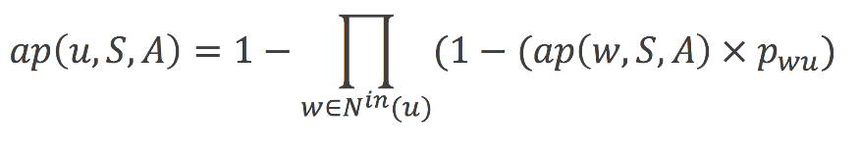
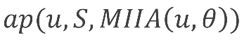
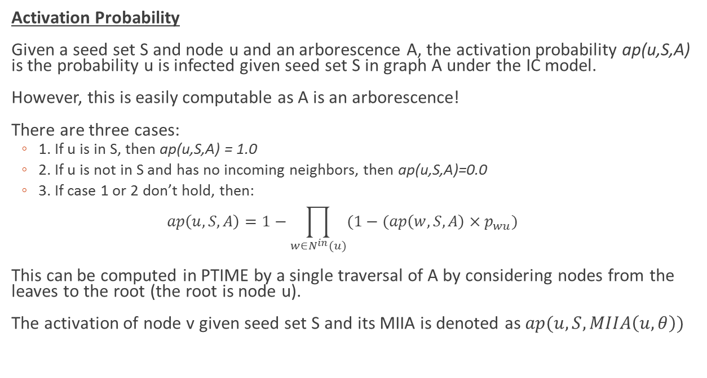
The MIA Model Formalism
Activation Probability
Given a seed set S and node u and an arborescence A, the activation probability ap(u,S,A) is the probability u is infected given seed set S in graph A under the IC model.
However, this is easily computable as A is an arborescence!
There are three cases:
1. If u is in S, then ap(u,S,A) = 1.0
2. If u is not in S and has no incoming neighbors, then ap(u,S,A)=0.0
3. If case 1 or 2 don’t hold, then:
This can be computed in PTIME by a single traversal of A by considering nodes from the leaves to the root (the root is node u).
The activation of node v given seed set S and its MIIA is denoted as

Slide 125
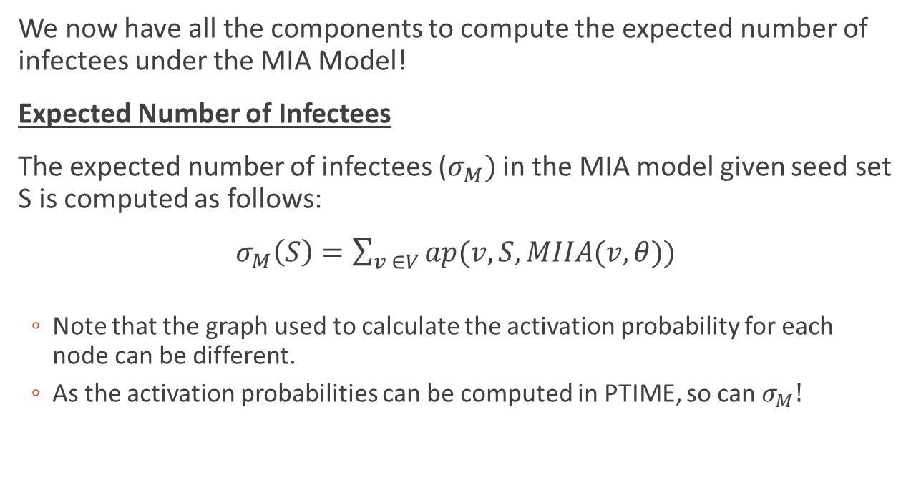
The MIA Model Formalism
We now have all the components to compute the expected number of infectees under the MIA Model!
Expected Number of Infectees
The expected number of infectees ($σ_{M})$ in the MIA model given seed set S is computed as follows:
$σ_{M}\left(S\right)=\sum_{v ∈V}{ap(v,S,MIIA(v,θ))}$
Note that the graph used to calculate the activation probability for each node can be different.
As the activation probabilities can be computed in PTIME, so can $σ_{M}!$

Slide 126
Influence Maximization under the MIA Model
Why do we have the MIA model? The goal is we want to create a more scalable approach to the influence maximization problem under the independent cascade (IC) model.
So, the goal is to replace the independent cascade model with the MIA model in the algorithm in the hope that the seed set returned provides a large number of infectees (in expectation) under the IC model.
Can we use the MIIA model in the greedy algorithm and still maintain any kind of theoretical guarantee?

Slide 127
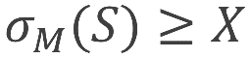
Influence Maximization under the MIA Model
Decision problem: Under the MIA model, given a natural number K and an real number X, does there a set of nodes S of size K such that ?
Complexity of Influence Maximization Under the MIA Model.
Membership:
In-NP! (solutions are verifiable in polynomial time)
Given a certificate (a set S) we can determine if it is of size K and if in polynomial time.
This is not the case for the IC model.

Slide 128
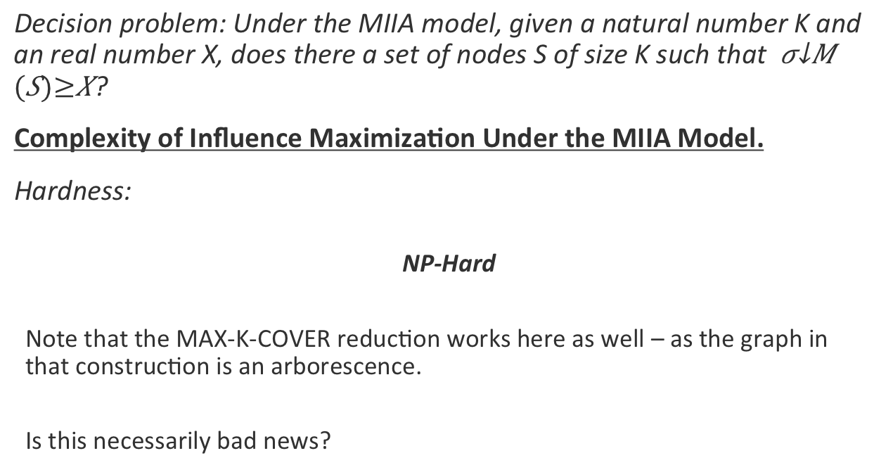
Influence Maximization under the MIA Model
Decision problem: Under the MIIA model, given a natural number K and an real number X, does there a set of nodes S of size K such that ?
Complexity of Influence Maximization Under the MIIA Model.
Hardness:
NP-Hard
Note that the MAX-K-COVER reduction works here as well – as the graph in that construction is an arborescence.
Is this necessarily bad news?

Slide 129
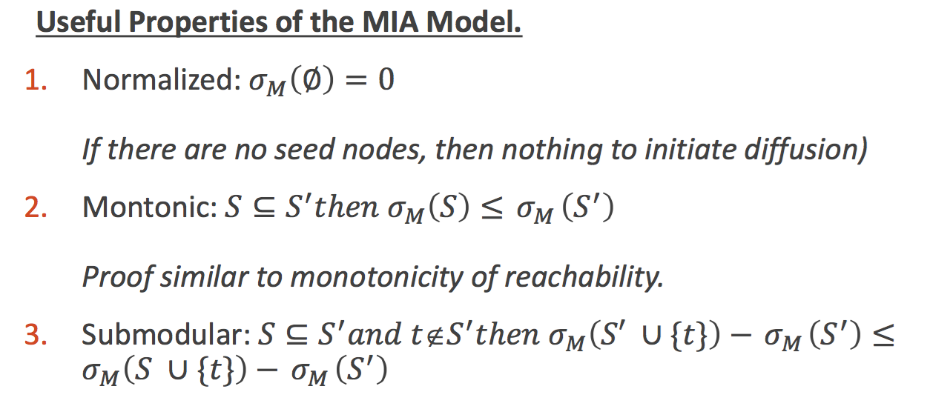
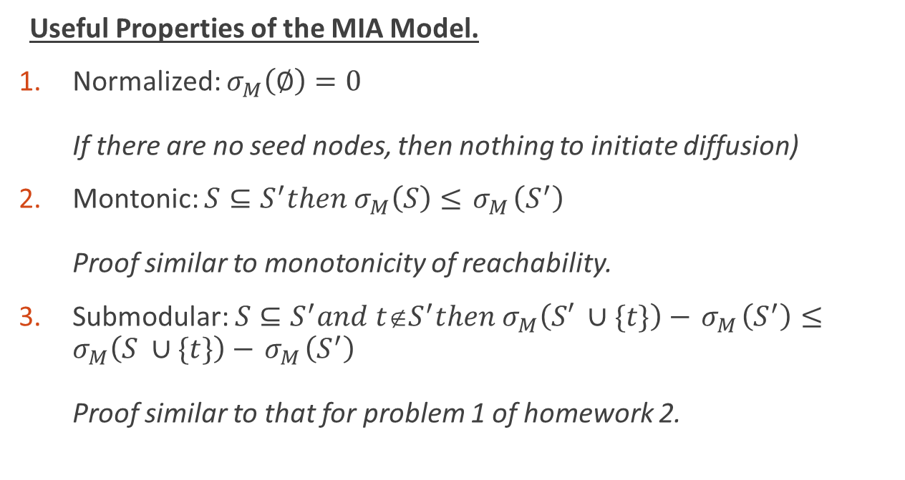
Influence Maximization under the MIA Model
Useful Properties of the MIA Model.
Normalized: If there are no seed nodes, then nothing to initiate diffusion)
Montonic: Proof similar to monotonicity of reachability.
Submodular: Proof similar to that for problem 1 of homework 2.

Slide 130
Greedy Algorithm
Standard greedy algorithm can be applied and achieve the ~0.63 (1-1/e) approximation ratio with respect to the expected number of infectees under the MIA model.
The greedy algorithm for the MIIA model possess no (known) theoretical properties with respect to the IC model!
However, we note that the results with respect to the MIA model hold if we use lazy evaluation.
Chen et al. demonstrate speedups to improving incremental increase specific to the MIIA model.

Slide 131
Extension: Prefix-Excluding MIIA
Issue: Suppose we are considering node w on the i’th iteration of the greedy algorithm. When we compute the activation probability of some node v, the shortest path from w to v has a node previously picked. This causes an incremental increase of node w to be zero (w.r.t. v).
Intuition: At each iteration, re-compute the in-arborescence for each node such that no paths from other nodes outside of S contain a node in S.
Notes:
In MIA the newly picked seed node may block the way of other seed nodes.

Slide 132
Extension: Prefix-Excluding MIIA
Chen et al. create a prefix-excluding variant of the MIA model (PMIA). They define a special version of MIIA (called PMIIA) that takes the current seed set into account.
Chen et al. then identify extensions to monotonicity and submodularity (prefix monotonicity and sequence submodularity) and show the PMIA model has these properties.
The greedy algorithm then is shown to achieve the 1-1/e approximation (with respect to the PMIA model).

Slide 133
Empirical Results
Performance in terms of expected number of infectees close to greedy
Several order-of-magnitude improvement in runtime (i.e. hours for greedy vs. seconds for MIIA/PMIA)
Outperforms centrality-based heuristics on large datasets (millions of edges)
Notes:
Next one is SIMPATH.
Say: now we want to come up with a model for LT…

Slide 134
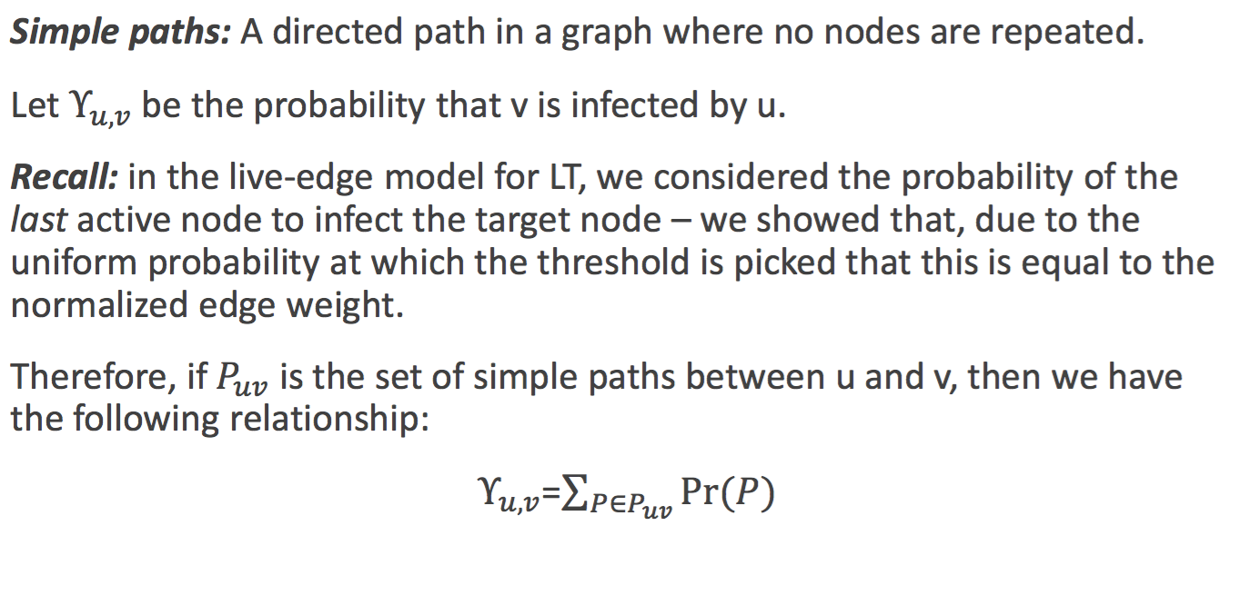
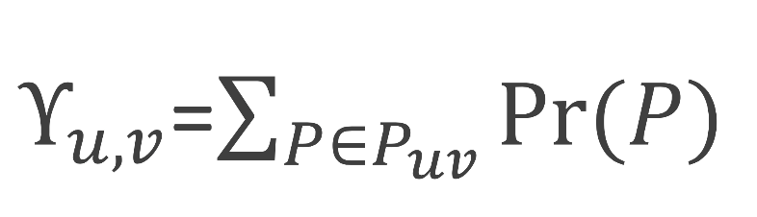
Intuition: Relationship to Simple Paths
Simple paths: A directed path in a graph where no nodes are repeated.
Let be the probability that v is infected by u.
Recall: in the live-edge model for LT, we considered the probability of the last active node to infect the target node – we showed that, due to the uniform probability at which the threshold is picked that this is equal to the normalized edge weight.
Therefore, if is the set of simple paths between u and v, then we have the following relationship:

Slide 135
New Property of the LT Model
For some subset X,S of V, Let $σ^{X}\left(S\right)$ be the expected number of infectees in the LT model given seed set S on the subgraph induced by the set of nodes in X.
We present the following Theorem: $σ\left(S\right)=\sum_{u∈S}{σ^{V−S+\left\{u\right\}}(\left\{u\right\})}$
Let $Υ_{s,v}$ be the probability of v being infected given initial seed set S – we will prove the theorem in terms of an individual node (the statement is then a summation over all nodes). Let $Υ_{s,v}(t)$ be the probability of v being infected given initial seed set S via all paths of length t. The equation below follows directly from this definition:
$Υ_{s,v}=\sum_{t}{Υ_{s,v}(t)}$

Slide 136
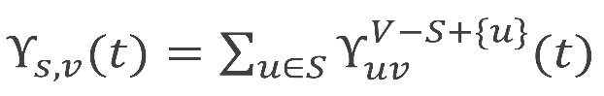
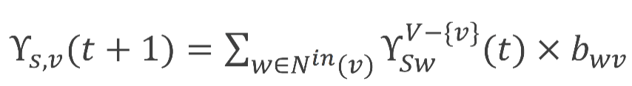
New Property of the LT Model
Hence, we want to show (for all t)
We do this by induction on t. For the base case (t=0), this is trivial as this is 1 if v is in S and 0 otherwise.
For the inductive step, let us assume the claim is true for t. Consider the path length of t+1. We have the following relationship:
Intuitively, the sum of the probability of the t+1 length paths to v is equal to the sum of each length t path to an incoming neighbor of v multiplied by the outgoing edge weight.
We can expand the summation and get the following:
The rest of the proof is simple algebraic manipulation.

Slide 137
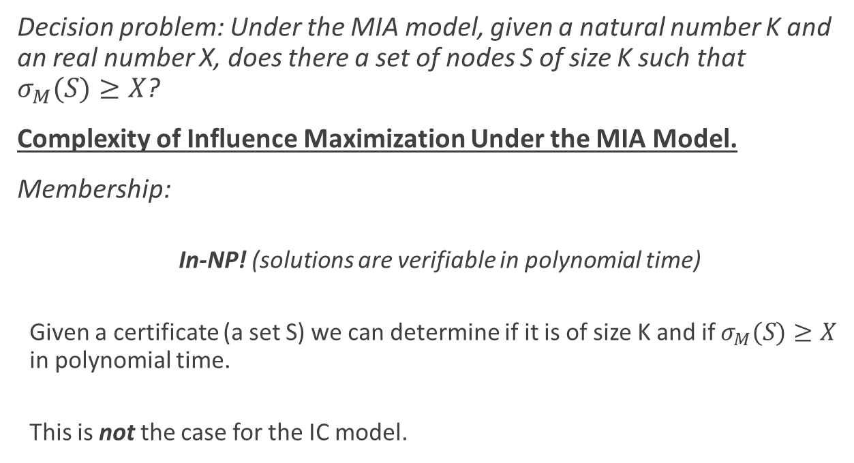
Computing Expected Number of Infectees by Enumerating Simple Paths
Consider the following from the theorem:
$σ\left(S\right)=\sum_{u∈S}{σ^{V−S+\left\{u\right\}}(\left\{u\right\})}$
This allows us to express the expected spread as a sum over the seeds.
And…
$Υ_{u,v}$=$\sum_{P∈P_{uv}}{Pr⁡(P)}$
This allows us to compute the probability of u influencing v as a sum of the simple path probabilities
And…
$σ\left(\{u\}\right)=\sum_{v∈V}{Υ_{u,v}}$
Which just means that the expected spread for a singleton is the sum of the probability of each node being influenced.
So, we can compute the expected number of infectees as follows:
$σ\left(S\right)=\sum_{u∈S}{\sum_{v∈V−S+\{u\}}{{\sum_{P∈P_{uv} on G(V−S+\left\{u\right\})}{Pr⁡(P)}}_{}}}$

Slide 138
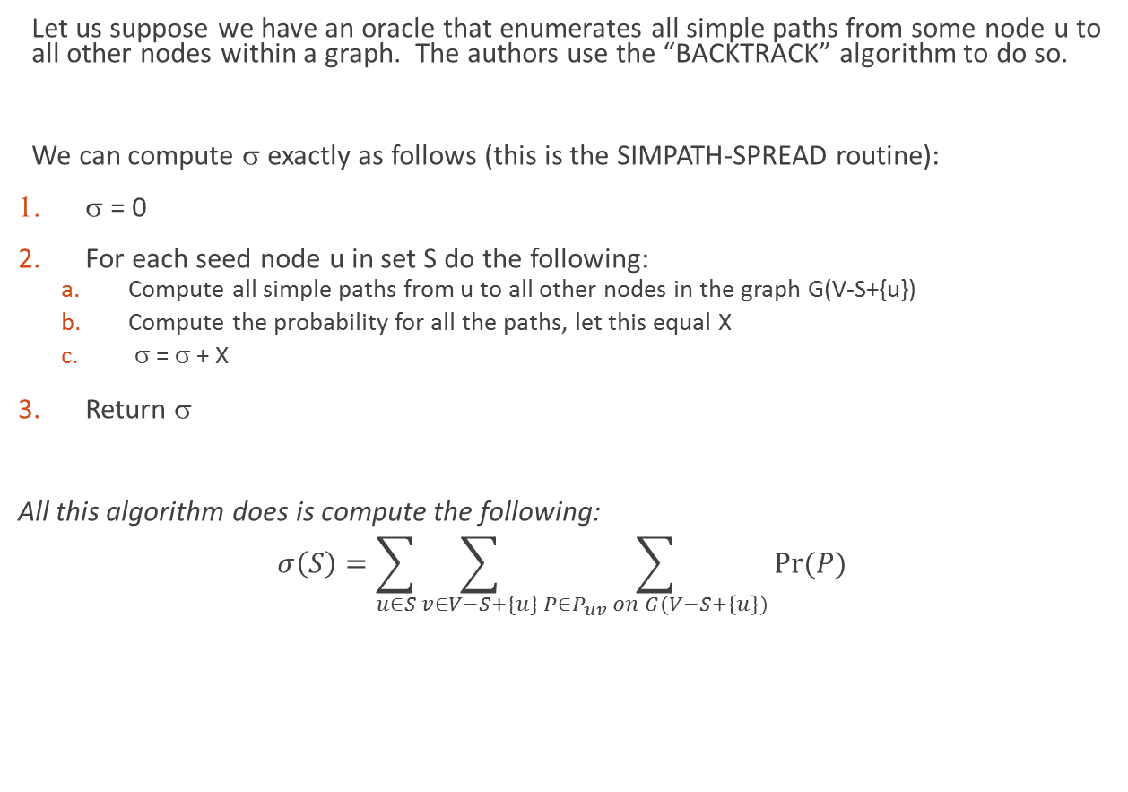
Computing σ
Let us suppose we have an oracle that enumerates all simple paths from some node u to all other nodes within a graph. The authors use the “BACKTRACK” algorithm to do so.
We can compute σ exactly as follows (this is the SIMPATH-SPREAD routine):
σ = 0
For each seed node u in set S do the following:
Compute all simple paths from u to all other nodes in the graph G(V-S+{u})
Compute the probability for all the paths, let this equal X
σ = σ + X
Return σ
All this algorithm does is compute the following:
$$σ\left(S\right)=\sum_{u∈S}{\sum_{v∈V−S+\{u\}}{{\sum_{P∈P_{uv} on G(V−S+\left\{u\right\})}{Pr⁡(P)}}_{}}}$$

Slide 139
Difficulty of Enumerating Paths
Recall: Computing the expected number of infectees in the LT model is #P hard because just counting the number of simple paths between nodes is #P hard (not to mention enumerating them.
So, the algorithm on the previous slide is not efficient (don’t wait for it to stop running!)
Intuition: The longer paths will occur with a much lower probability (the influence events are independent, so we multiply the edge weights)

Slide 140
Difficulty of Enumerating Paths
Intuition: The longer paths will occur with a much lower probability (the influence events are independent, so we multiply the edge weights)
Heuristic: Only enumerate the paths that have a probability greater than a certain amount.
Hence, SIMPATH computes a lower bound on the expected number of infectees – the hope is that the paths it does not consider don’t add up to a whole lot which would make the lower bound tight.
This is not an approximation guarantee – there are currently no known results regarding how close this bound is to the actual expected value.

Slide 141
Influence Maximization Using SIMPATH-SPREAD
The overall algorithm for scalable influence maximization under the LT model is called SIMPATH and calls SIMPATH-SPREAD to approximate σ.
The authors of SIMPATH (Goyal et al.) leverage lazy submodular evaluation as well as some graph-theoretic techniques to limit the calls to SIMPATH-SPREAD.
However, one major issue is to limit the number of calls to SIMPATH spread on the first iteration of the greedy algorithm.

Slide 142
Another Useful Property of the LT Model…
Theorem: $σ\left(\{v\}\right)=1+\sum_{u∈N^{out}(v)}{b_{vu}σ^{V−\left\{v\right\}}(\left\{u\right\})}$
Consider all simple paths that start at v. The second node is always one of v’s out-neighbors and a particular out-neighbor is infected based on the edge-weight. The remainder of the path starts at the outgoing neighbor and can traverses through the nodes in G (except for node v).

Slide 143
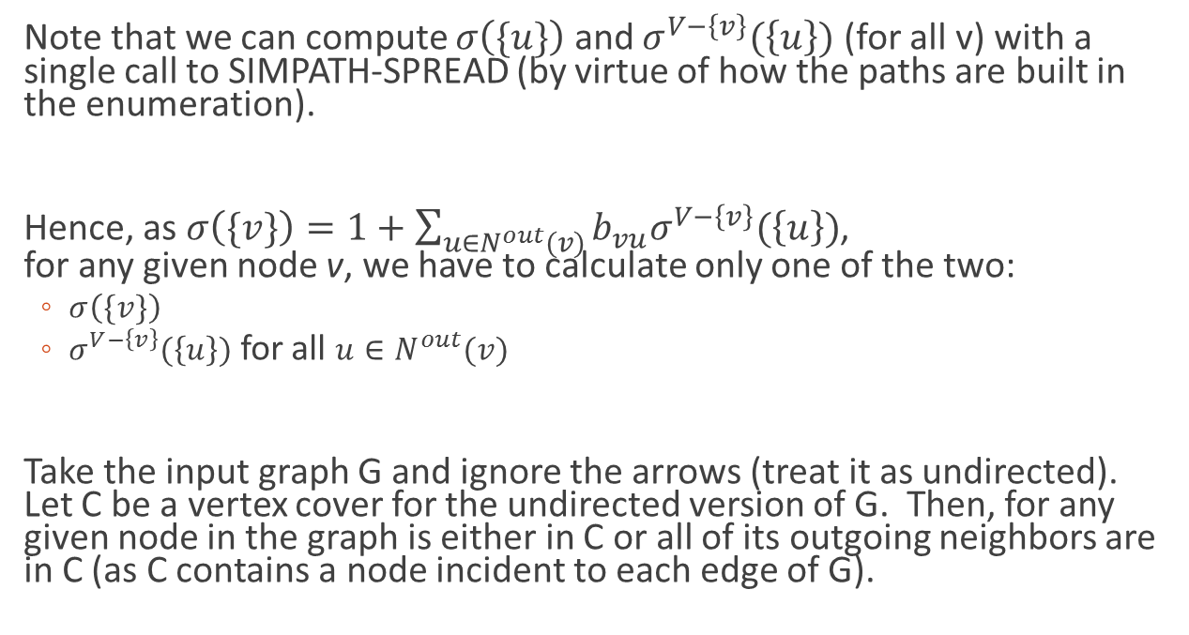
Another Useful Property of the LT Model…
Note that we can compute $σ\left(\{u\}\right)$ and $σ^{V−\left\{v\right\}}(\left\{u\right\})$ (for all v) with a single call to SIMPATH-SPREAD (by virtue of how the paths are built in the enumeration).
Hence, as $σ\left(\{v\}\right)=1+\sum_{u∈N^{out}(v)}{b_{vu}σ^{V−\left\{v\right\}}(\left\{u\right\})}$, for any given node v, we have to calculate only one of the two:
$σ\left(\{v\}\right)$
$σ^{V−\left\{v\right\}}(\left\{u\right\})$ for all $u∈N^{out}(v)$
Take the input graph G and ignore the arrows (treat it as undirected). Let C be a vertex cover for the undirected version of G. Then, for any given node in the graph is either in C or all of its outgoing neighbors are in C (as C contains a node incident to each edge of G).

Slide 144
Vertex Cover
So, if we find a vertex cover of the graph, we can reduce the number of nodes for which we have to run SIMPATH-SPREAD on the first iteration of the greedy algorithm.
Finding a minimal vertex cover is NP-hard.
But, we just need a small vertex cover.
Polynomial time approximation is available for vertex cover, but the authors resort to a heuristic that takes maximum degree nodes for performance reasons.

Slide 145
Putting it all together.
SIMPATH uses SIMPATH-SPREAD to approximate the expected number of infectees
Enumerates simple paths with a probability greater than or equal to some threshold
When the threshold is zero, then SIMPATH-SPREAD provides an exact result
SIMPATH leverages lazy sub-modular evaluation
SIMPATH shortens the runtime of the first iteration by computing SIMPATH-SPREAD for nodes within a vertex cover
Other speedups are obtained with some graph-theoretic techniques

Slide 146
SIMPATH Experimental Results
SIMPATH performed comparable to the Greedy algorithm in terms of expected number of infectees.
SIMPATH provided 3-4x order of magnitude improvement over the Greedy (even with lazy evaluations) in terms of runtime.
SIMPATH out-performed degree centrality, PageRank, and LDAG (another scalable method for LT) in terms of expected number of infectees.
SIMPATH scales: Largest graph experimented on (reported by Goyal et al.) had 914K nodes and 6.6M edges.

Slide 147
Key Takeaways
SIMPATH provides an ~0.63 approximation when the threshold for the probability of simple paths is set to zero.
Unlike MIIA (which is actually an alternative model to IC), SIMPATH works by finding a bound on the expected number of infectees
Goyal et al. were able to create highly-efficient approximation algorithm for influence maximization under the LT model by repeatedly identifying where the greedy algorithm was running slowest and creating theoretically correct work-around’s to increase performance.

Slide 148
Reference
Kempe, David and Kleinberg, Jonand and Tardos. Maximizing the spread of influence through a social network. (2003) ACM 137–146.
Nemhauser, George L and Wolsey, Laurence A and Fisher, Marshall L. An analysis of approximations for maximizing submodular set functionsI. (1978) 14(1) 265–294.
Wang,ChiandChen,WeiandWang,Yajun. Scalable influence maximization for independent cascade model in large-scale social networks. (2012) Data Mining and Knowledge Discovery 25(3) 545–576.
Mossel, Elchanan and Roch, Sebastien. On the submodularity of influence in social networks. (2007) ACM 128–134.
Goyal, Amit and Lu, Wei and Lakshmanan, Laks VS. Simpath: An efficient algorithm for influence maximization under the linear threshold model.(2011) Data Mining (ICDM), 2011 IEEE 11th International Conference, 211–220.
Chen, Wei and Yuan, Yifei and Zhang, Li. Scalable influence maximization in social networks under the linear threshold model. (2010) Data Mining (ICDM), 2010 IEEE 10th International Conference, 88–97

Slide 149
SIR and SIS Models
Tipping Model and Target Set Selection
Kempe-Kleinberg-Tardos (KKT) Framework Part I
Kempe-Kleinberg-Tardos (KKT) Framework Part II
Logic Programming Based Diffusion
Evolutionary Graph Theory (EGT)
Empirical Results
Data-driven approaches
Open Problems

Slide 150
Damon Centola’s Study (Science, 2010)
Two theories:
High clustering not important in diffusion – “shortcuts” much more important
Implies spreading more readily occurs on a random network
Local clustering important
Implies that a variant of the tipping model is more suitable and spreading will not occur as easily on a random network

Slide 151
Damon Centola’s Study (Science, 2010)
An online social network was set up for the 128 experimental participants.
Participants were connected to others in the study in one of two groups:
Lattice network
Random network
Participants could only communicate with their immediate neighbors (“health buddies”) through the interface of the online social network – and no one else

Slide 152
Damon Centola’s Study (Science, 2010)
Six diffusion processes initiated on each of the two networks.
For each process, a random seed node was selected to adopt a new behavior.
Anytime an individual adopted a behavior, messages were sent to all of his/her health buddies.
If an individual had multiple health buddies previously adopting, they then received multiple signals.
Varied the size of the network and number of health buddies each user had.

Slide 153
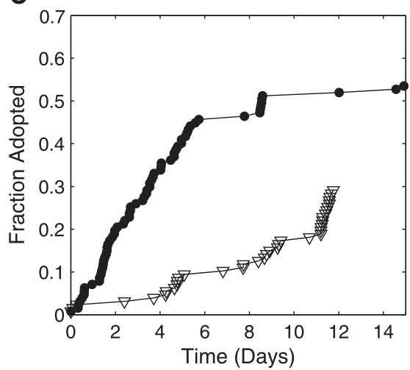
Damon Centola’s Study (Science, 2010)
Main Result: Health behaviors spread to a larger portion of the population in the lattice network
High clustering
Large Diameter
Lattice
Random
Centola, Damon. "The spread of behavior in an online social network experiment." science 329.5996 (2010): 1194-1197.

Slide 154
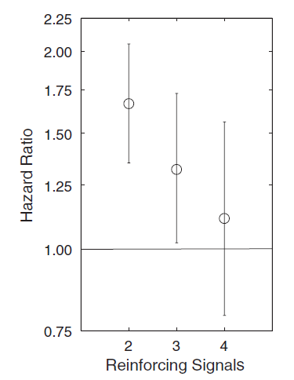
Results
Hazard Ratio: Ratio of adopting with k signals as opposed to k-1 signals.
95% confidence intervals shown.
Key take-away: Significant effect with additional signals for up to three signals
Centola, Damon. "The spread of behavior in an online social network experiment." science 329.5996 (2010): 1194-1197.

Slide 155
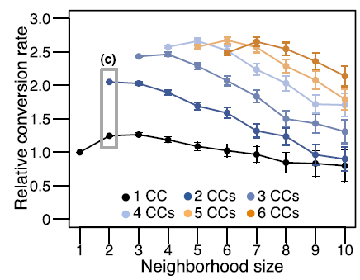
Ugander’s Results (PNAS ‘12)
Ugander et al. (PNAS, 2012) show for email influencers, the number of adopters is not strictly monotonic if we consider the number of connected components within an ego-network.
Ugander, Johan, et al. "Structural diversity in social contagion." Proceedings of the National Academy of Sciences (2012): 201116502.

Slide 156
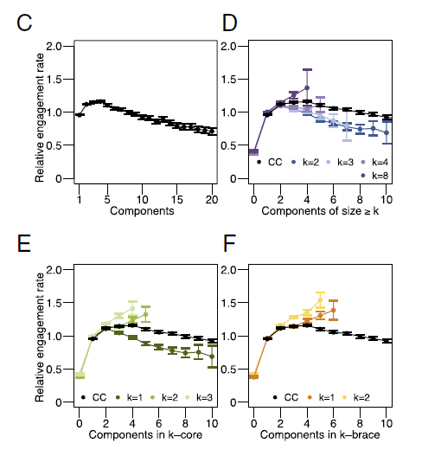
Ugander’s Results (PNAS ‘12)
Ugander, Johan, et al. "Structural diversity in social contagion." Proceedings of the National Academy of Sciences (2012): 201116502.

Slide 157
Ugander’s Results (PNAS ‘12)
Ugander, Johan, et al. "Structural diversity in social contagion." Proceedings of the National Academy of Sciences (2012): 201116502.

Slide 158
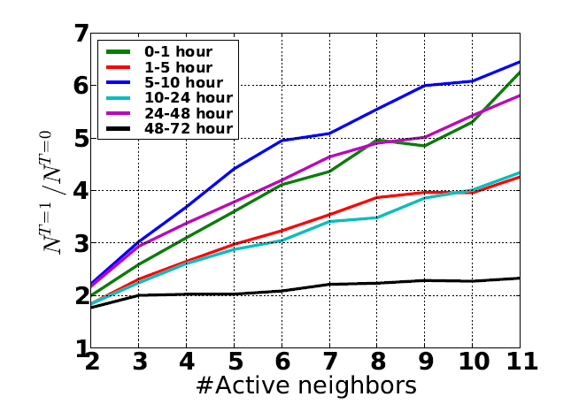
Zhang et al.’s Results (IJCAI ‘13)
Here number of neighbors is shown (again) to be a positive indicator of influence (Weibo dataset)
However, they noticed that influence decays with time.
Zhang, Jing, et al. "Social influence locality for modeling retweeting behaviors." Proceedings of the Twenty-Third international joint conference on Artificial Intelligence. AAAI Press, 2013.

Slide 159
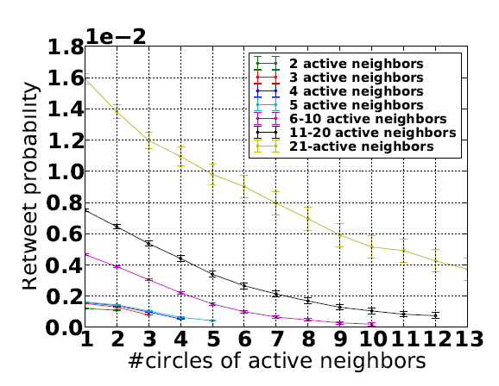
Zhang et al.’s Results (IJCAI ‘13)
Contrary to Ugander’s result, Zhang et al. found that (on Weibo) that retweet probability was negatively coorelated with structural diversity.
Zhang, Jing, et al. "Social influence locality for modeling retweeting behaviors." Proceedings of the Twenty-Third international joint conference on Artificial Intelligence. AAAI Press, 2013.

Slide 160
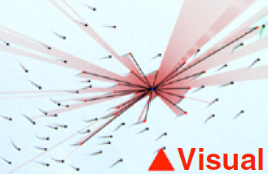
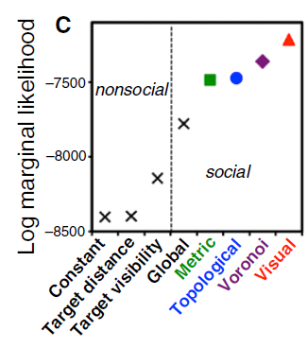
Tipping in Schools of Fish (Yes, Really)
How do schools of fish change group behavior?
Fish in the school change behavior based on visual cues
Biologists (Strandburg-Peshkin et al.) created networks based on what the fish see
Again, a tipping process was observed.
Strandburg-Peshkin, Ariana, et al. "Visual sensory networks and effective information transfer in animal groups." Current Biology 23.17 (2013): R709-R711.

Slide 161
Attributes and Homophily
Attributes: Different characteristics about nodes and edges
Can be discrete
Can be real-valued
Homophily: Similarity between two nodes or edges based on attributes

Slide 162
The Role of Attributes in Diffusion
Aral and Walker (2012) illustrate the importance of attributes for diffusion:
People over 31 are less susceptible to influence than younger people
Men are more susceptible to influence than women
Married people are less susceptible to influence than people engaged to be married
A key result: individuals who are more influential tend to be less susceptible.
An open question: how doe these relationships change when we consider the content of the message diffusing? (we will address this somewhat with the data-driven approaches).

Slide 163
Homophily
Homophily - the similarity among individuals in a population.
The “homophily principle” refers to the notion that similar individuals adopt similar behaviors
“Like influences like”
“Birds of a feather flock together”

Slide 164
Homophily Relvance to Network Science
Network Growth and Models: Some researchers argue that homophily plays an important part in network evolution (Papadopoulos et al., Nature 2013) and should be considered in models of network growth.
Homophily vs. Diffusion: For certain diffusion processes, (such as the adoption of a piece of software), adoption may be the result of homophily instead of diffusion (i.e. if incoming neighbor v adopts before v’ and both are similar, is the adoption due to network effects, homophily, or both?) (Aral et al., PNAS 2009)
Note: Homophily vs. diffusion is less of an issue in certain cases based on data (i.e. retweets in certain social networks, cases where there is no concurrent broadcast means, etc.)

Slide 165
Homophily and Diffusion
The effect of homophily on diffusion was explored in an empirical study (Science, Centola, 2011) where the spread of a health behavior was observed among lattice-network populations of homophilis and randomly-placed indivdiuals.
Individuals in the homphoilis network were arranged such that they would be closer to similar individuals based on gender, age, and BMI (body-mass index).
There were 5x experiments where two networks of 72 individuals each were examined.
Using a hazard-ratio analysis, the authors of the study found that homophily significantly effects diffusion.

Slide 166
Influence vs. Diffusion
Work on influence describes the influence relationship between two individuals
The work on diffusion describes how a contagion diffuses through a network
NB: These should be viewed as complementary lines of research.
A logic-based approach allows us to study diffusion as it emerges from local influence.

Slide 167
Reference
Ugander, Johan, et al. "Structural diversity in social contagion." Proceedings of the National Academy of Sciences (2012): 201116502.
Zhang, Jing, et al. "Social influence locality for modeling retweeting behaviors." Proceedings of the Twenty-Third international joint conference on Artificial Intelligence. AAAI Press, 2013.
Centola, Damon. "The spread of behavior in an online social network experiment." science 329.5996 (2010): 1194-1197.
Centola, Damon, et al. "Homophily, cultural drift, and the co-evolution of cultural groups." Journal of Conflict Resolution 51.6 (2007): 905-929
Centola, Damon. "An experimental study of homophily in the adoption of health behavior." Science 334.6060 (2011): 1269-1272.
Strandburg-Peshkin, Ariana, et al. "Visual sensory networks and effective information transfer in animal groups." Current Biology 23.17 (2013): R709-R711.
Aral, Sinan, and Dylan Walker. "Identifying influential and susceptible members of social networks." Science 337.6092 (2012): 337-341.

Slide 168
SIR and SIS Models
Tipping Model and Target Set Selection
Kempe-Kleinberg-Tardos (KKT) Framework Part I
Kempe-Kleinberg-Tardos (KKT) Framework Part II
Logic Programming Based Diffusion
Evolutionary Graph Theory (EGT)
Empirical Results
Data-driven approaches
Open Problems

Slide 169
Data-Driven Approaches
Learn model parameters from past diffusion processes
Probabilities of arcs in IC model
Weights in LT model
Parameters of CD model
Directly leverage features of past diffusion processes
Graphical structure
Content
Individual attributes

Slide 170
Where do the probabilities come from?
Recall: in the Independent Cascade (IC) model we assume we have a vector of weights for each edge (w,v) that correspond to the probability of w infecting v given w was previously infected and v was not.
For experiments where there is no historical data, several approaches have been used:
Assign all values the same (SIR)
Assign probabilities proportional to degree
Tri-valence – randomly assign one of three values
But what if we do have historical diffusion traces? Can we learn these probabilities?

Slide 171
Learning Influence Probabilities through Expectation-Maximization
Some notation:
D is a historical trace of a diffusion process from time 0 to T-1.
D(t) is the set of nodes in D infected at time t
B(v), F(v) are incoming/outgoing neighbors of v

Slide 172
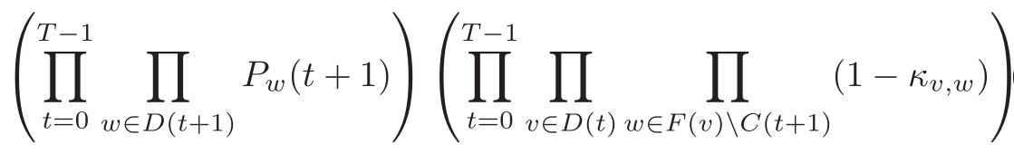
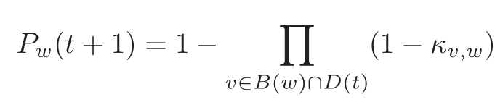
Observing a given diffusion trace
The probability of observing a given diffusion trace is:
Where κ_{v,w} is the probability of v infecting w and P_{w}(t) is defined as follows:

Slide 173
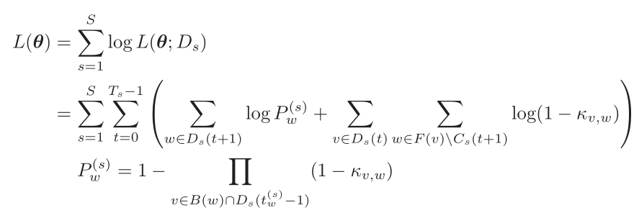
Log-Likelihood Function
Based on the probability of observing a given trace, we have:
Problem: Find edge probabilities that maximize the above log-likelihood function.
Difficult to analyze

Slide 174
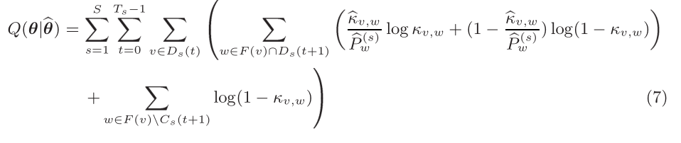
E-M Approach
Q is the expected log-likelihood of a set of parameters given the previous parameter estimate.
1.0
Probability of v activating w given that w activates (based on the last parameters)
Probability of v NOT activating w given that w activates (based on the last parameters)
The probability of v not activating w given w not activating is always 1.0.

Slide 175
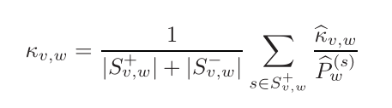
Good News…
We can analytically find the derivative of Q and solve for the parameters, hence given the last estimate of parameters, we can solve for the new set of parameters using the following:
Note: We can view this as the average conditional probability of activation (the average of probabilities of activation given that w was activated and the probabilities of activation given that w was not activated)

Slide 176

Putting It All Together
Expectation Step:
Estimate the success probabilities of each node
Maximization Step:
Find the new edge probabilities that maximize Q.

Slide 177
Experiments
Experiments in the original paper on applying E-M to finding influence probabilities in the IC model did so under the following conditions:
“Ground truth” consisted of randomly generated edge probabilities (not real diffusion traces)
Single network of 12K nodes, 80K edges
Issues with this approach
Scalability (may be possible through extensive parallelization)
E-Step: Compute a product for each node and each diffusion trace
M-Step: Compute a summation for each edge that can potentially be the size of the set of diffusion traces
In other work, edge probabilities were found to be very small (later work addresses this by considering only subsets of edges)
E-M has a tendency to over-fit

Slide 178
Other (More Scalable) Ways to Model Influence
Static Models: Influence probabilities do not change with time
Dynamic Models: Influence probabilities change with time
Notes:
Static: independent of time. Simple to learn.

Slide 179
Bernoulli
Each trial is an independent event.
$p_{v,u}=\frac{Number of traces where v was infected followed by u being infected}{Number of traces where v was infected}$
Notes:
any time a contagious user v tries to influence its inactive neighbor u, it has a fixed probability of making u activate. If u activates, it is a successful attempt. Each attempt, which is associated with some action, can be viewed as a Bernoulli trial.

Slide 180
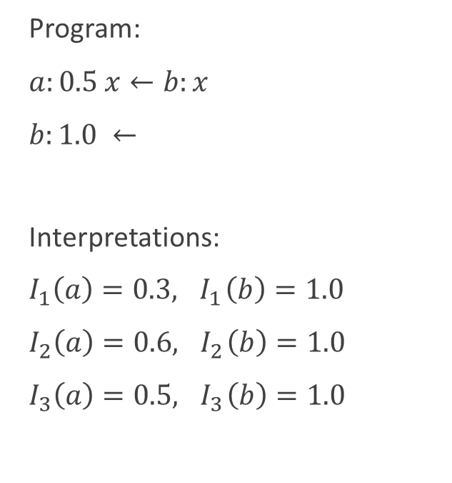
Jaccard
Probability proportional to similarity among traces
$p_{v,u}=\frac{Number of traces where v was infected followed by u being infected}{Number of traces where v or u was infected}$
Notes:
Used for set similarity.

Slide 181
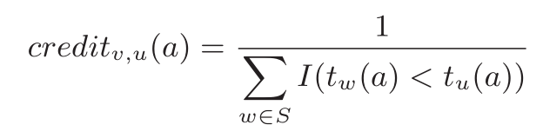
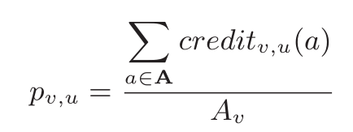
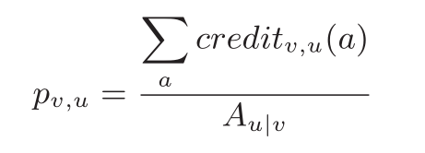
Partial Credits
Credit defined as follows:
The credit of edge (v,u) for action a is the reciprocal of the fraction of influencers on u for that action
We can have credit-based versions of Bernoulli and Jaccard models as shown below:
Bernoulli
Jaccard
Notes:
We give credit to the neighboring nodes which previously adopted a.

Slide 182



Temporal Effects
Influence was found to decay exponentially with time
Hence, Goyal et al. introduce continuous-time models (4 variants based on the static models)
Strongest influence
Avg. time to influence
Notes:
I am more likely to do sth. in \tav_v,u time interval after my neighbor has done that.
\tav_v,u is the expected time of doing action a.
At first when I am exposed, I want to adopt the behavior immediately.
As time goes on, it is less likely to adopt sth.
$p^0_v,u$: can be estimated in exactly the same was as for the static models => four variation of this model
$\tau_v,u$: corresponds to the expected time delay between v performing an action and u performing the same action. Can be approximated as avg. time to influence.

Slide 183


Incremental Updating
The probability of u being infected by S plus an additional node
Continuous time models are not incremental in nature! (Static models are)
Notes:
This makes the computation faster. We don’t need to recompute everything each time a new node adopts.

Slide 184
Discrete Time Models
Best of both worlds:
Models time
Able to perform Incremental updates
Relies of a discretizing of time
Again, four variants
Notes:
The node will be influenced in time interval t + \tav. \tav time after the neighbor has adopted sth.
Continuous Time Models are not incremental in nature, hence they are very expensive in terms of run time required for testing
the influence of an active user v on its neighbor u remains constant at p_v,u for a time window of τ_v,u after v performs the action. After that it drops to 0, i.e. a user v is contagious for u in the time interval [tv,tv +τv,u].

Slide 185
Experiments
Flick data set, actions are joining a group (1.3M users, 40.5M edges, 35.9M tuples for historical data)
All models can be learned in two scans of the diffusion traces
Utilizes generalized threshold model, so a node activates when the probability exceeds a certain value. The threshold is the same for all nodes – used to trade-off true-positive-rate (TPR) for false-positive-rate (FPR)
Model performance measures in terms of AUC based on prediction of individuals taking an action

Slide 186
Main Empirical Results
Dynamic outperformed static models
Bernoulli models outperformed Jaccard Models
Partial credit Bernoulli models slightly out-performed standard Bernoulli models
Discrete time models were comparable to continuous time models

Slide 187


Main Empirical Results
ROC comparison of 4 variants of Static Models
ROC comparison of 4 variants of Discrete Time (DT) Models
Goyal, Amit, Francesco Bonchi, and Laks VS Lakshmanan. "A data-based approach to social influence maximization." Proceedings of the VLDB Endowment 5.1 (2011): 73-84.
Notes:
Dynamic outperformed static models
Bernoulli models outperformed Jaccard Models
Partial credit Bernoulli models slightly out-performed standard Bernoulli models
Discrete time models were comparable to continuous time models

Slide 188

Comparison of Standard Approaches
Tri-valence (red)
Degree-weighted (green)
Uniform (blue)
EM (pink)
Goyal, Amit, Francesco Bonchi, and Laks VS Lakshmanan. "A data-based approach to social influence maximization." Proceedings of the VLDB Endowment 5.1 (2011): 73-84.

Slide 189


New Approach: Credits (Again)
Total credit for v influence u for action a:
Base case: γ_{u,u}=1
Note that in the implementation, a threshold is used to limit credit value (avoids quadratic computation).
Notes:
(credit v has received from u)
\gamma_v,u: giving credit to the neighboring nodes which adopted before me. v \in N_in. can do this in different ways. Another way in the next slide…
\Gamma: distribute the credit transitively backward in the diffusion graph. Not v get the credit, but they will pass the credit to their predecessors in the diffusion trace.
Constrained the sum of the credit a node gives to its neighbors to be no more than 1.

Slide 190


Extensions
Sets of nodes:
Time:
Notes:
Simple generalization of the definition.
More sophisticated way to define the direct credit.
Inf(.): user influenceability. Fraction of actions u has done under the influence of at least one of his neighbors.

Slide 191


Credit Distribution Example
1
x
0.5
v
0.5
t
1
1
S={v, z}
0.25
0.25
w
z
0.25
u
0.25

Slide 192



Aggregate Credits / Credit-Distribution Model
Here κ is credit – not an edge weight.
Notes:
A_u is the set of actions done by u. messages u has tweeted for instance.
1) Average of credit given to v from u.
2) Generalized for set S
3)inf. Spread. Total influence credit given to S by all the nodes in the social network.

Slide 193
Properties of σ_{cd}
Can you guess?
Normalized
Monotonic
Submodular
Associated influence maximization problem:
NP Hard

Slide 194

Experiments
CD (Credit Distribution)
IC model with EM-learned weights
LT model with static Bernoulli-learned weights
Goyal, Amit, Francesco Bonchi, and Laks VS Lakshmanan. "A data-based approach to social influence maximization." Proceedings of the VLDB Endowment 5.1 (2011): 73-84.
Notes:
Root mean squared error for the given size of spread.

Slide 195

Experiments
CD (Credit Distribution)
IC model with EM-learned weights
LT model with static Bernoulli-learned weights
Goyal, Amit, Francesco Bonchi, and Laks VS Lakshmanan. "A data-based approach to social influence maximization." Proceedings of the VLDB Endowment 5.1 (2011): 73-84.
Notes:
Proportion of diffusions captured by each model captured given an absolute error.=> estimated – actual
For abs error=30, CD captured 60%

Slide 196

Influence Maximization Experiments
Conducted w.r.t. CD model results (due to lack of data)
Goyal, Amit, Francesco Bonchi, and Laks VS Lakshmanan. "A data-based approach to social influence maximization." Proceedings of the VLDB Endowment 5.1 (2011): 73-84.

Slide 197

Runtime (Influence Maximization)
Goyal, Amit, Francesco Bonchi, and Laks VS Lakshmanan. "A data-based approach to social influence maximization." Proceedings of the VLDB Endowment 5.1 (2011): 73-84.

Slide 198
Data-Driven Approaches
Learn model parameters from past diffusion processes
Probabilities of arcs in IC model
Weights in LT model
Parameters of CD model
Directly leverage features of past diffusion processes
Graphical structure
Content
Individual attributes

Slide 199
Key Questions
Can we predict when a trend in social media will “go viral”
Create a regression model, based on features, predict the size of the cascade
Identify which Tweets will be re-tweeted over 1000 times
Predict when an existing information cascade will double in size

Slide 200
General Argument Against Maximum Influence
Influence maximization (in all models studied thus far) makes the assumption that the model is realistic and we can select nodes to optimize spread (seed or target set) based on that model.
Great results have been shown analytically and in simulation, but perhaps the models are too far away from reality to be useful (i.e. building an airplane without considering drag).

Slide 201

Empirical Study on Twitter (2011)
Subgraph of twitter 56M nodes, 1.7B edges
75M Tweets
Studied the propagation of shortened “bit.ly” URL’s

Slide 202
Large Cascades are Rare
Our study on a Sina Weibo dataset (17.9M users, 22M Tweets) confirmed the previously-observed power-law relationship between cascade size and frequency
Hence, when viewed as a classification problem, the classes are highly imbalanced
Guo, R., Shaabani, E., Bhatnagar, A., Shakarian, P., “Toward Order-of-Magnitude Cascade Prediction in Social Networks,” ASONAM, 2015.

Slide 203
Which Features are Predictive?
Anecdotal evidence on cascades often ends up highlighting features that may be necessary but not sufficient. The problem stems from the relative rarity of large cascades.
The goal of Bakshy et al. (2011) was to accurately predict cascade size.

Slide 204

Features Used
Local – number immediate followers reposting information (within 1 month)
Global – total size of overall cascade

Slide 205
Classification Technique
Regression tree
Similar to a decision tree, but rather than identifying classes at the leaves, provides a regression function.
Bakshy et al. (2011) utilized a constant function (whose value is the mean of the data specified in a leaf)
Partitions determined greedily
Hence, the regression tree specifies a piecewise function
Multiple trees created using folded cross-fold validation to avoid overfitting

Slide 206

Classification Technique

Slide 207

Comparison to Ground Truth
Data split into two 1-month periods (training and test)
Note that (due to the piece-wise function specified by the regression tree) that cascades are only predicted to have certain sizes.
The prediction for the average at each size fits the linear model well (R² = 0.98)
However, the overall fit is poor (R²=0.34)
Bakshy, Eytan, et al. "Everyone's an influencer: quantifying influence on twitter." Proceedings of the fourth ACM international conference on Web search and data mining. ACM, 2011.

Slide 208
Why the Poor Fit?
The regression tree revealed that past local performance and number of followers were indicative of future performance.
The authors point out that this is likely due to the large number of cascades of depth 1.
Again, note that the training data is highly skewed.

Slide 209

Necessary but not sufficient…
Bakshy, Eytan, et al. "Everyone's an influencer: quantifying influence on twitter." Proceedings of the fourth ACM international conference on Web search and data mining. ACM, 2011.

Slide 210

Content: A First Try
The authors also examined content based on 1000 manually encoded samples (selected in a manner stratified amongst the different sized cascades).
When added to the classification model, they actually caused a decrease in model fit.
Bakshy, Eytan, et al. "Everyone's an influencer: quantifying influence on twitter." Proceedings of the fourth ACM international conference on Web search and data mining. ACM, 2011.

Slide 211

Content: A First Try
However, the categories themselves were interesting.
Bakshy, Eytan, et al. "Everyone's an influencer: quantifying influence on twitter." Proceedings of the fourth ACM international conference on Web search and data mining. ACM, 2011.

Slide 212
A Closer Look at Content
Jenders et al. (WWW 2013) also look at content as well as some aspects about the initial Twitter.
21.8M Original Tweets, 4.2M Retweetss
15K users
The examine the following features:
Number of followers
Tweet length
Hashtags
Mentions (mentioning other Twitter users)
Sentiment
Valence
Divergence
Positive-Negative Score Pairs

Slide 213

Followers and Tweet Length
Avg. number of retweets increases with number of followers
Avg. number of retweets increases with length until 120 characters, then decreases.
Jenders, Maximilian, Gjergji Kasneci, and Felix Naumann. "Analyzing and predicting viral tweets." Proceedings of the 22nd international conference on World Wide Web companion. International World Wide Web Conferences Steering Committee, 2013.

Slide 214
Sentiment
Based on an algorithm known as “SentiStrength” each Tweet has a positive and negative sentiment score.
Sentiment Valence: If the overall Tweet is predominantly positive or negative
Emotional Divergence: The absolute value of the difference between the two scores
Individual Sentiments: The actual positive-negative score pair.

Slide 215
Sentiment
Sentiment Valence: Probability of retweeting higher under the condition that the Tweet was primarily negative.
Emotional Divergence: Highly divergent Tweets often re-tweeted.
Individual Sentiments: (Next slide)

Slide 216

Sentiment Scores
Jenders, Maximilian, Gjergji Kasneci, and Felix Naumann. "Analyzing and predicting viral tweets." Proceedings of the 22nd international conference on World Wide Web companion. International World Wide Web Conferences Steering Committee, 2013.

Slide 217

Classifiers
Logistic regression: $P\left(N\left(x\right)>T \right| x )= \frac{1}{1+e^{−w_{0}+\sum_{i}{w_{i}x_{i}}}}$
Where x is the feature vector and the w_{i} values are learned weights for each feature. N(x) is the number of retweets for the Tweet represented by feature vector x and T is a threshold.
Authors note the utility of this model as it does not assume independence among features (i.e. there is a dependence between number of hashtags and Tweet length)
The authors compare with a Naïve Bayes classifier as a baseline.

Slide 218
Experimental Setup
Authors note that their logistic model learns best when values from the feature vector are often repeated – hence feature values were discretized.
Ran different experiments where the parameter T was set to different values (50, 100, 500, 1000).
Cross-fold validation used, for each T value training and test sets were selected in a balanced manner (i.e. ½ Tweets retweeted greater than T times)

Slide 219

Results
High F1-scores on both Logistic and NB models; logistic out-performs NB.
However, note that the training and test sets were selected to be balanced.

Slide 220
Dealing with the Data Imbalance
Cheng et al. (WWW ‘14) are less selective in their training and test sets and accept the inherent data imbalance.
However, they look at a different query: given a cascade that has already started, can we predict when it will double in size?
Recall: cascade size is related to frequency by a power-law. Hence, predicting when a given cascade will exceed the median gives us a balanced binary classification problem. Further, if the cascade exceeds the median size, it has at least doubled.

Slide 221

Features
Cheng, Justin, et al. "Can cascades be predicted?." Proceedings of the 23rd international conference on World wide web. International World Wide Web Conferences Steering Committee, 2014.

Slide 222

Features
Cheng, Justin, et al. "Can cascades be predicted?." Proceedings of the 23rd international conference on World wide web. International World Wide Web Conferences Steering Committee, 2014.

Slide 223

Sensitivity to Initially Observed Cascade
Cheng, Justin, et al. "Can cascades be predicted?." Proceedings of the 23rd international conference on World wide web. International World Wide Web Conferences Steering Committee, 2014.

Slide 224
Feature Importance
Some findings noted on the predicative ability of various features
Features based on averages were more predictive when the initial cascade was larger
The original post (followers of the seed node, how the content was posted) becomes a less important predictor when the initial cascade size is large
Content itself becomes a less important predictor as the initial cascade grows
Large cascades have a high conversion rate and grow quickly; importance of temporal features stable
Structure is important, but becomes less important over time (though reshare depth is highly correlated)

Slide 225
New Research
In our recent work, we develop features for order-of-magnitude cascade prediction (50 to 500 adopters).
Results are based on a Sina Weibo dataset that exhibits a power-law distribution.
A_{m}: New features
B_{m}: Previous state-of-the-art (Weng et al., 2014, ICWSM)
C_{m}: Baseline (average adoption time)
Numbers shown are for the viral class, under 2% of the samples (10-fold cross validation; error bars show 1× s.d.)
Guo, R., Shaabani, E., Bhatnagar, A., Shakarian, P., “Toward Order-of-Magnitude Cascade Prediction in Social Networks,”ASONAM, 2015.
Notes:
We identify cascades of size 50 that grow to size 500 with precision of 0.69 and recall of 0.52 (for the viral class, <2% of samples)
Analogous results for cascades that have progressed for 60 minutes
Demonstrate how to trade precision for recall allowing us to obtain precision of 0.78 or recall of 0.71 (at the expense of the other) for the viral class

Slide 226
Reference
Goyal, Amit, Francesco Bonchi, and Laks VS Lakshmanan. "Learning influence probabilities in social networks." Proceedings of the third ACM international conference on Web search and data mining. ACM, 2010.
Cheng, Justin, et al. "Can cascades be predicted?." Proceedings of the 23rd international conference on World wide web. International World Wide Web Conferences Steering Committee, 2014.
Bakshy, Eytan, et al. "Everyone's an influencer: quantifying influence on twitter." Proceedings of the fourth ACM international conference on Web search and data mining. ACM, 2011.
Guo, R., Shaabani, E., Bhatnagar, A., Shakarian, P., “Toward Order-of-Magnitude Cascade Prediction in Social Networks,” ASONAM, 2015.
Jenders, Maximilian, Gjergji Kasneci, and Felix Naumann. "Analyzing and predicting viral tweets." Proceedings of the 22nd international conference on World Wide Web companion. International World Wide Web Conferences Steering Committee, 2013.

Slide 227
Concluding remarks
Paulo Shakarian, Ph.D.
shak@asu.edu
Ashkan Aleali
aleali@asu.edu

Slide 228
Diffusion in Social Networks
In Fall, 2015, Springer will be publishing a new volume:
Diffusion in Social Networks
Provides more in-depth coverage on the topics of this tutorial.
A preprint, along with these slides can be found at:
http://lab.engineering.asu.edu/cysis/diffusion/

Slide 229
Open Problems
Non-monotonic diffusion applied to social media
Diffusion in networks that change over time
i.e. Michalski et al., 2014
The relationship between influence and diffusion
Sequential seed set selection
i.e. POMDP’s, adaptive submodularity
Human subjects testing (leading to improved diffusion models)
Real world deployment

